Slide 1




CLOUD STORAGE WITH "DROPBOX"

Slide 2
Web location for this presentation:
http://aztcs.org
Click on
“Meeting Notes”

Slide 3
SUMMARY
You can use "Dropbox" cloud storage to protect yourself from the losing data files and to access your data files on multiple computers, cell phones, and computing devices.

Slide 4
Dropbox's Server Farms
See https://blogs.dropbox.com/tech/2019/01/the-scalable-fabric-behind-our-growing-data-center-network/

Slide 5
REPORT CARD FOR "DROPBOX"
AMOUNT OF FREE STORAGE? | 2 GB
RELIABLE UPLOAD AND DOWNLOAD OF ENTIRE FOLDERS CONTAINING DATA FILES? | Yes for computers but no for iOS
NO KNOWN DATA SECURITY COMPROMISES? | No !!
ONLINE CREATION, VIEWING, AND EDITING OF DOCUMENT FILES AND PHOTOS? | Yes
"ZERO KNOWLEDGE" OF YOUR PASSWORD OR YOUR STORED DATA FILES | No
5

Slide 6
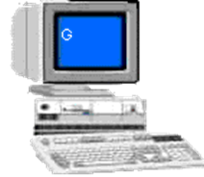
Internet Connection
Windows.. or Mac.. Computer
to Access "Dropbox"
Web Browser to access dropbox.com
Special "Dropbox" Folder Provided by the App
"Dropbox" App Provided by the Dropbox company
6

Slide 7
Internet Connection
Linux.. Computer
to Access"Dropbox"
Web Browser to access dropbox.com
Special "Dropbox" Folder Provided by the App
"Dropbox" App Provided by a third-party developer
7

Slide 8
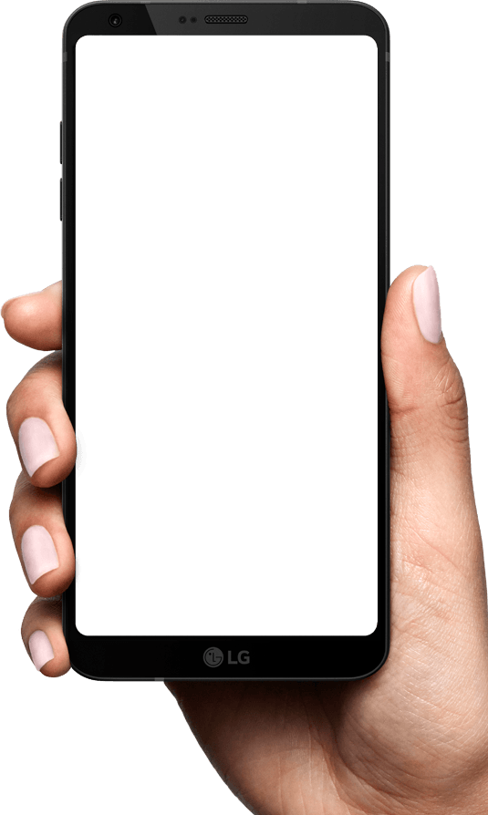
Internet Connection
Cell Phone or Tablet to Access
"DropBox"
Web Browser to access dropbox.com
"Dropbox"App Provided by the Dropbox company
8

Slide 9
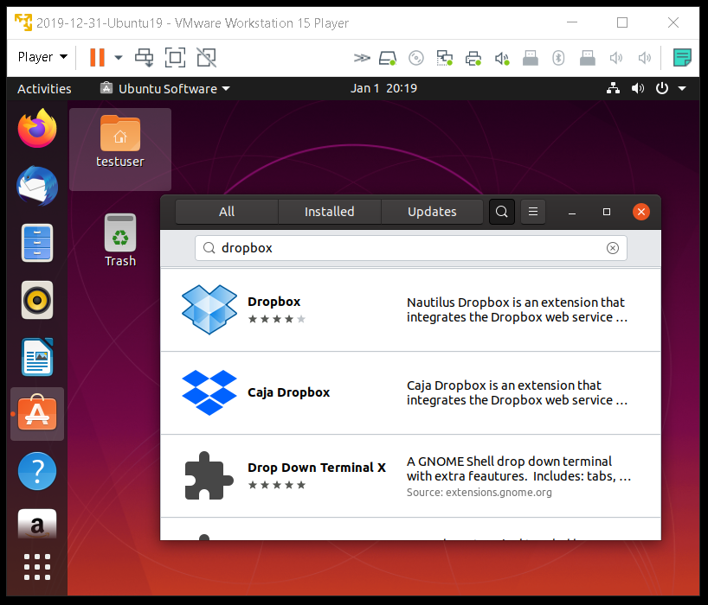

Slide 11
DROPBOX'S FEATURES
See https://zapier.com/blog/dropbox-hidden-features/#sync

Slide 12
DROPBOX SYNC LIMITATIONS
See https://zapier.com/blog/free-dropbox-account-three-device-limit/

Slide 13
"DROPBOX" SECURITY LAPSES
See https://en.wikipedia.org/wiki/Criticism_of_Dropbox#January_2017_accidental_data_restoration

Slide 14
DROPBOX "SELECTIVE SYNC"
See https://help.dropbox.com/installs-integrations/sync-uploads/selective-sync-overview

Slide 15
"DROPBOX PAPER"
"Dropbox Paper" is an online document processing app that can import files of almost any format
"Dropbox Paper" stores files online in a proprietary form. These files cannot be downloaded to your computer
See https://en.wikipedia.org/wiki/Dropbox_Paper

