Slide 1




CLOUD STORAGE USING "BOX"

Slide 2
Web location for this presentation:
http://aztcs.org
Click on
“Meeting Notes”

Slide 3
SUMMARY
You can use "Box" cloud storage to protect yourself from the losing data files and to access data files on multiple computers, cell phones, and computing devices.

Slide 4
"Box" Server Farms
Box.com uses a mixture of Amazon Web Services' "EC2" virtual cloud servers combined with their own servers in 10 leased data centers
Their leased data centers are located in Palo Alto, California Portland, Oregon Chicago, Illinois New York state Sao Paulo, Brazil Amsterdam, Netherlands Tokyo, Japan Singapore Sydney, Australia

Slide 5
"Box" Server Farms (continued)
See https://www.businessinsider.com/box-ceo-explains-aws-competitors-2016-3

Slide 6
REPORT CARD FOR "BOX"

Slide 7
REPORT CARD FOR "BOX"
AMOUNT OF FREE STORAGE? | 10 GB
RELIABLE UPLOAD AND DOWNLOAD OF ENTIRE FOLDERS CONTAINING DATA FILES? | Yes
NO KNOWN DATA SECURITY COMPROMISES? | Yes
ONLINE CREATION, VIEWING, AND EDITING OF DOCUMENT FILES AND PHOTOS? | Yes
"ZERO KNOWLEDGE" OF YOUR PASSWORD OR YOUR STORED DATA FILES | No
7

Slide 8
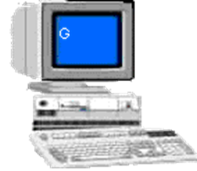
Internet Connection
Computer to Access "Box"
Web Browser to access box.com
Special "Box" Folder Provided by the "Box" app
"Box" App Provided by the Box company
8

Slide 9
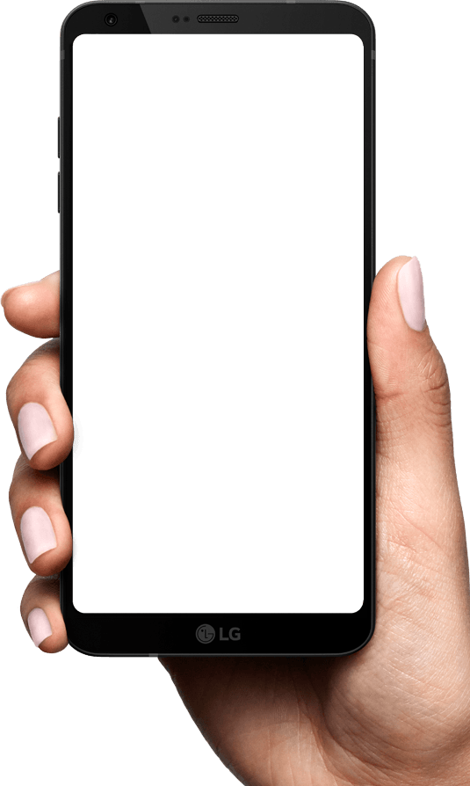
Internet Connection
Cell Phone or Tablet to Access "Box"
Web Browser to access box.com
"Box" App Provided by the Box company
9

Slide 10
USING A WEB BROWSER TO TO UPLOAD FILES AND FOLDERS TO THE "BOX" SERVER FARM

Slide 11
You can upload files and folders after using a Web browser to access the "Box" server farm

Slide 12
USING A WEB BROWSER IN "WINDOWS.." TO TO UPLOAD FILES AND FOLDERS TO THE "BOX" SERVER FARM:

Slide 16
You can download files and folders after using a Web browser to access the "Box" server farm:

Slide 17
When you download files using a Web browser, they will arrive in your local computer in native format.
When you download a folder using a Web browser, it will arrive in your local computer as zip file.

Slide 18
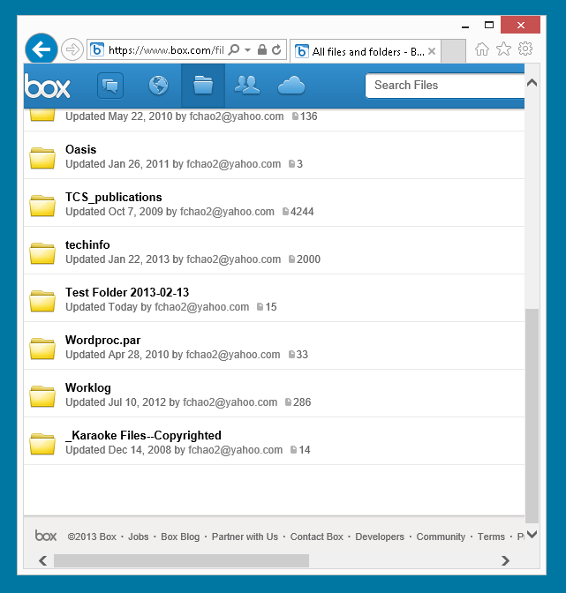

Slide 19
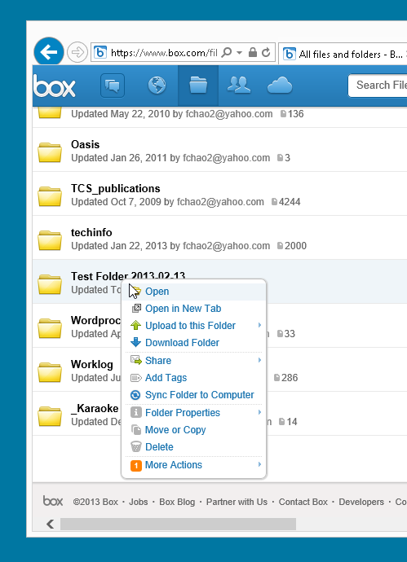

Slide 20
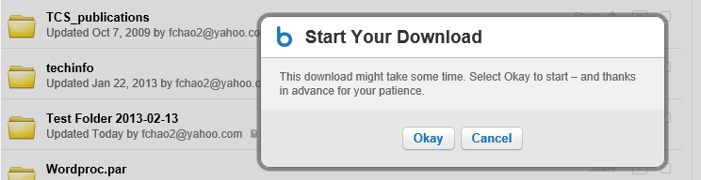

Slide 21
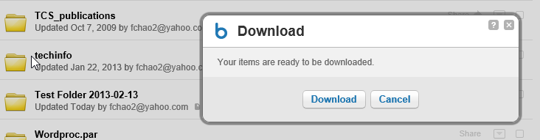

Slide 22
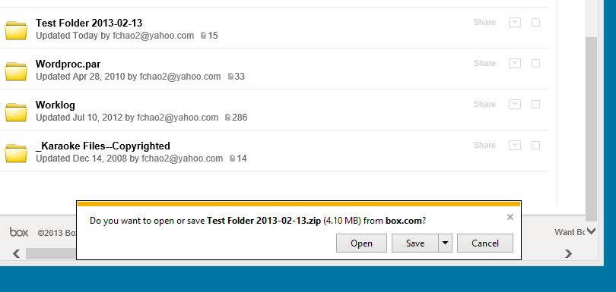

Slide 23
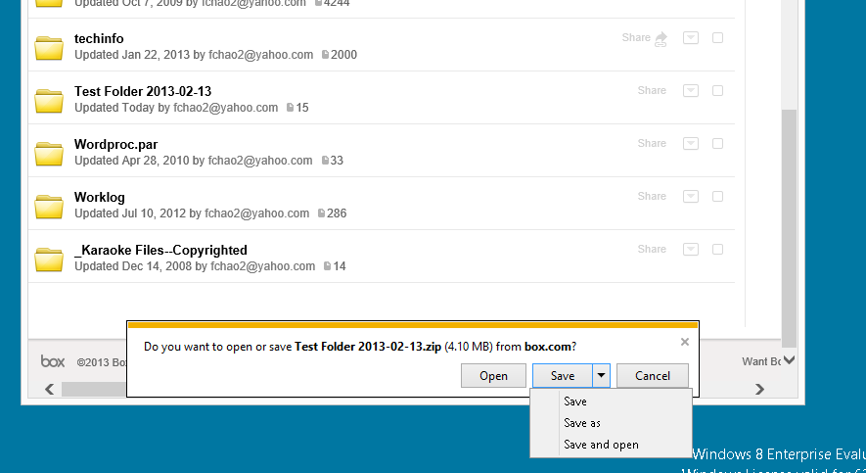

Slide 24
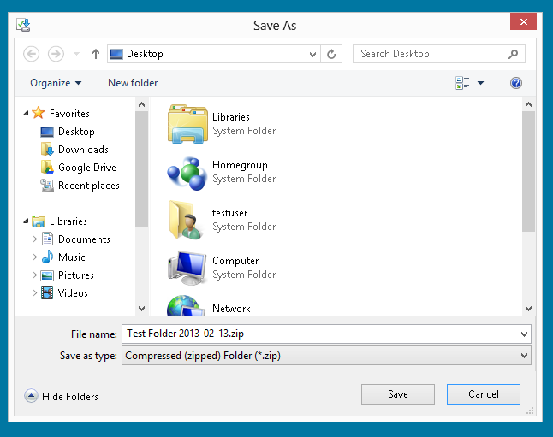

Slide 25
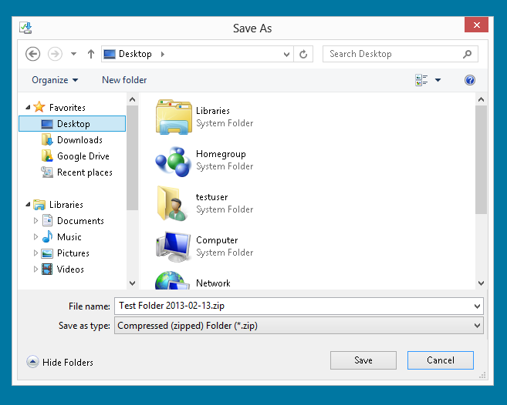

Slide 26
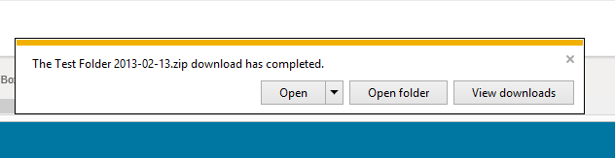

Slide 27
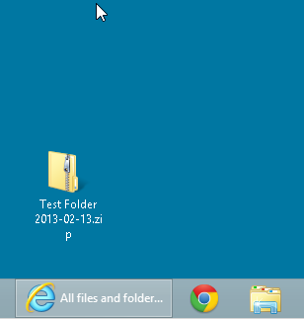

Slide 28
When you use a Web browser to download a file from the "Box" server farm: the "Box" server farm zips the folder before sending it to the "Downloads" folder of your local computer.

Slide 29
USING A THE "BOX SYNC" PROGRAM WHICH PROVIDES A SPECIAL "BOX SYNC" FOLDER IN "FILE EXPLORER" OR THE MAC "FINDER" TO UPLOAD FILES AND FOLDERS TO THE "BOX" SERVER FARM:

Slide 48
ACCESSING "BOX" FROM A WEB BROWSER

Slide 49
From the Desktop of "Windows 10" or "Windows 8.1", the main way to access your 5 Gigabytes of free storage at "Box" is by using a Web browser such as "Google Chrome", "FireFox", or "Edge":

Slide 50
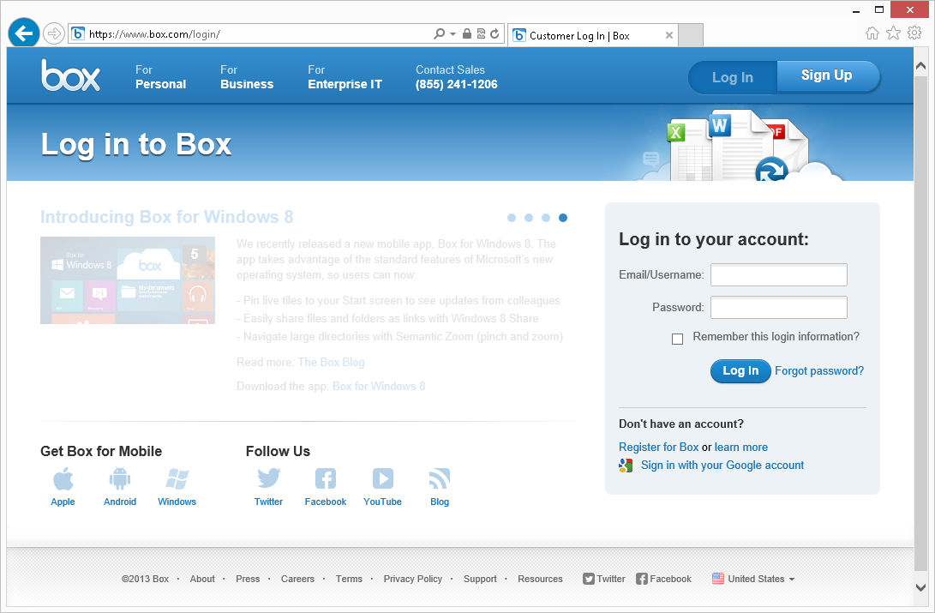

Slide 51
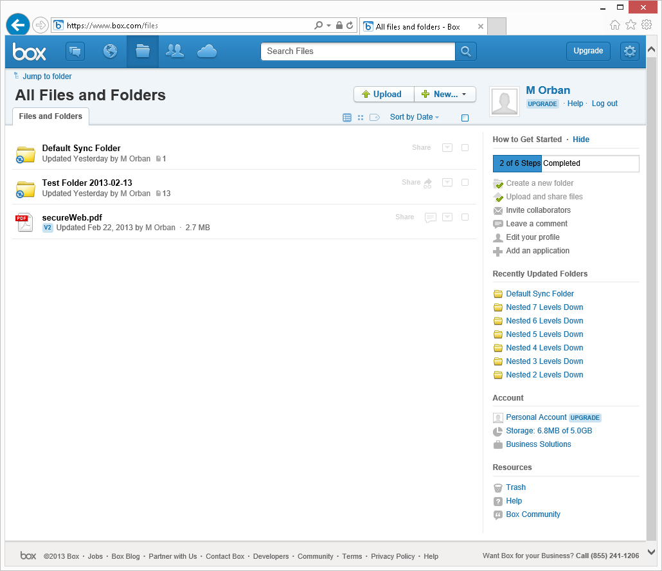

Slide 52
USE THE FREE "BOX SYNC" SOFTWARE PROGRAM TO SYNCHRONIZE FILES BETWEEN A "WINDOWS.." PC (OR A MAC) AND THE "BOX" SERVER FARM

Slide 53
For a PC running "Windows XP", "Windows Vista", "Windows 7", or "Windows 8", or a Mac running "OS X", you can install "Box Sync" so that "Box" will automatically synchronize files and folders between your a "My Box Files" folder in a Windows PC or a "Box Documents" folder in a Mac and the files that you store at the "Box" server farm. See https://support.box.com/entries/20364863-Box-Sync-System-Requirements

Slide 54
REQUIREMENTS FOR BOX SYNC FOR PC/MAC

Slide 55
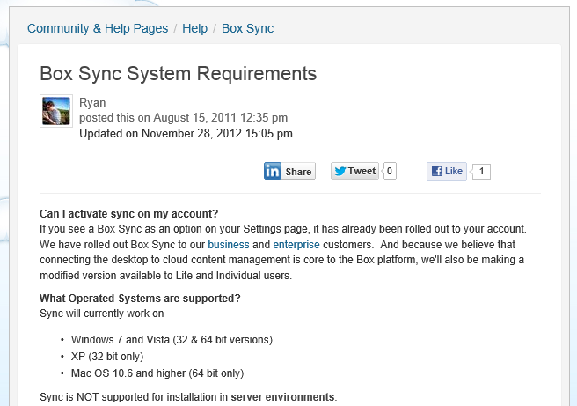

Slide 56
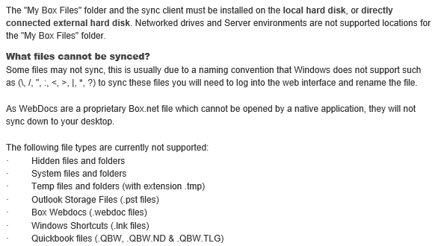

Slide 57
To download "Box Sync" into you Mac or "Windows.." computer, go to https://www.box.com/download-box-sync/

Slide 58
USING A WEB BROWSER TO VIEW OR EDIT DATA FILES THAT ARE STORED AT THE "BOX" SERVER FARM

Slide 59
If you double-click on a file, a default viewer displays the file in a "read-only" mode:

Slide 60
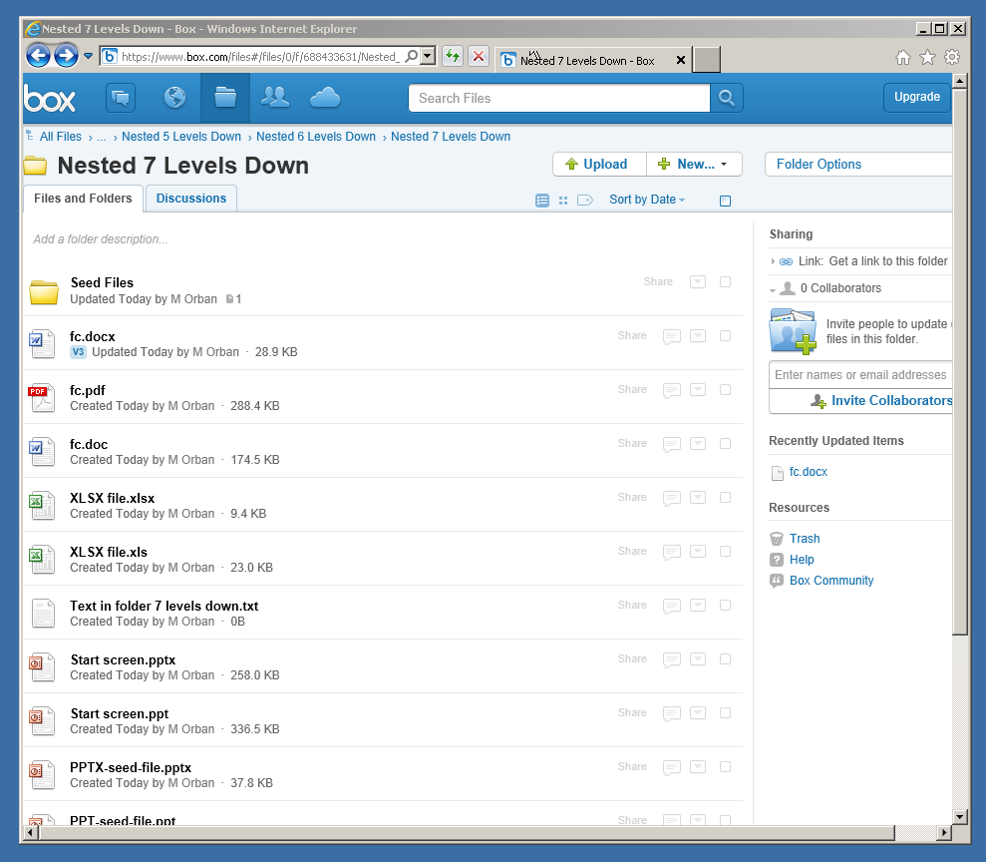

Slide 61
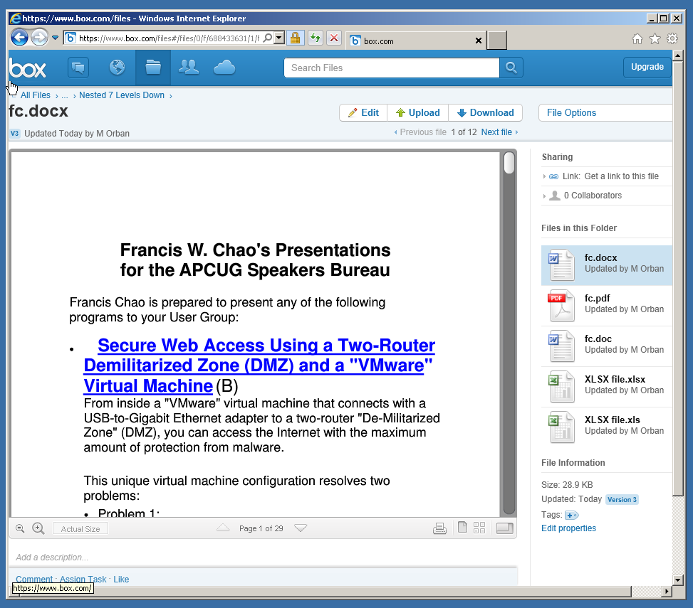

Slide 62
If you click on the "More Options" button for the file, you have several options:

Slide 63
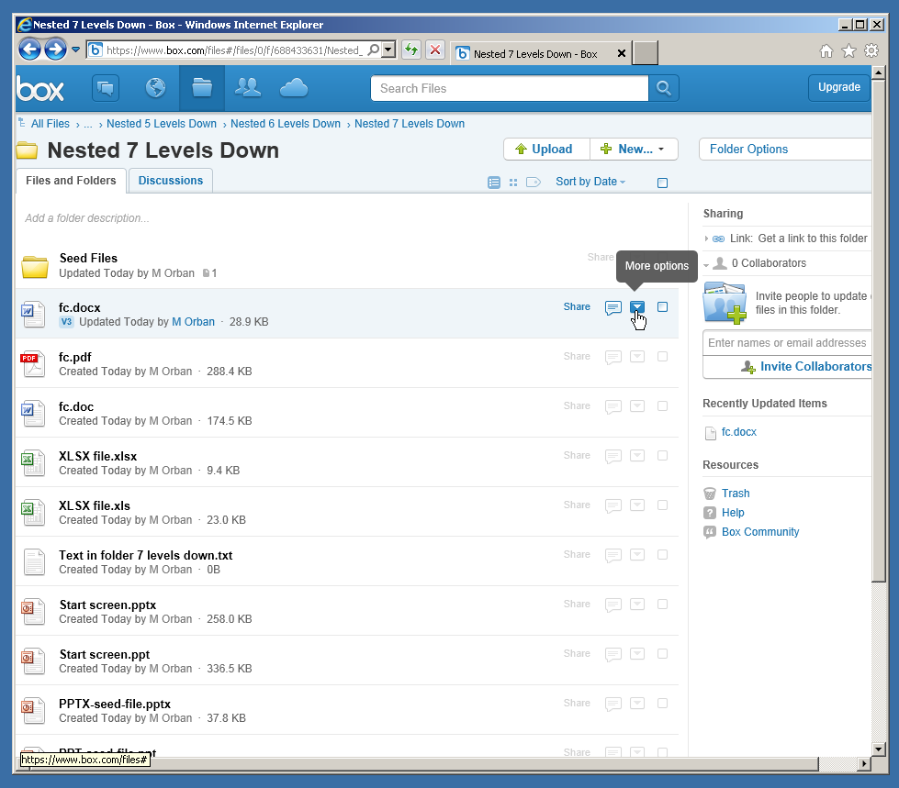

Slide 64
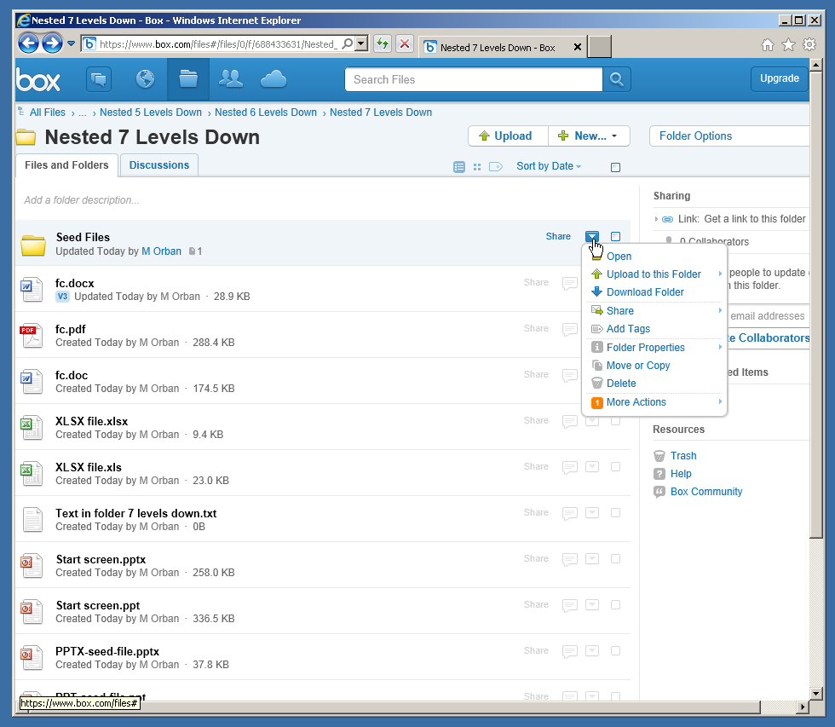

Slide 65
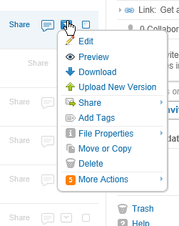

Slide 66
If you click on "Edit" in the pop-up context menu, you will either install or run "Box Edit" program which will automatically download the file to your local computer so that you can edit it there with whatever software is available on your local computer. When you close the local application program, you the "Box Edit" program send the file back up to "Box" to replace the original file.

Slide 67
Details about "Box" (continued)
The free "Box Edit" program lets you use the default application on your local computer (such as "Microsoft Office..", "LibreOffice", or "OpenOffice") to open and edit files that are stored at the "Box" server farm. See https://support.box.com/entries/22144503-Box-Edit-Overview-and-FAQs

Slide 69
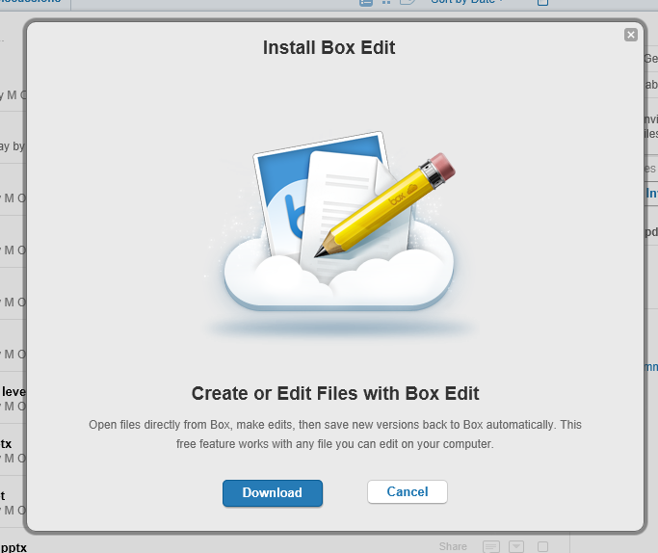

Slide 70
Clicking on "Preview" on the pop-up context menu is the same as double-clicking on the name of the file. You get an online, read-only preview of the file. This read-only preview is provided by the Box.net server farm.

Slide 72
Clicking on "Download" downloads the file down to a local hard drive on your computer, where you can edit the file with your locally-installed software such as "Microsoft Office..", the free "LibreOffice", or the free "OpenOffice":

Slide 74
Clicking on "More Actions", a second pop-up context menu will be displayed:

Slide 76
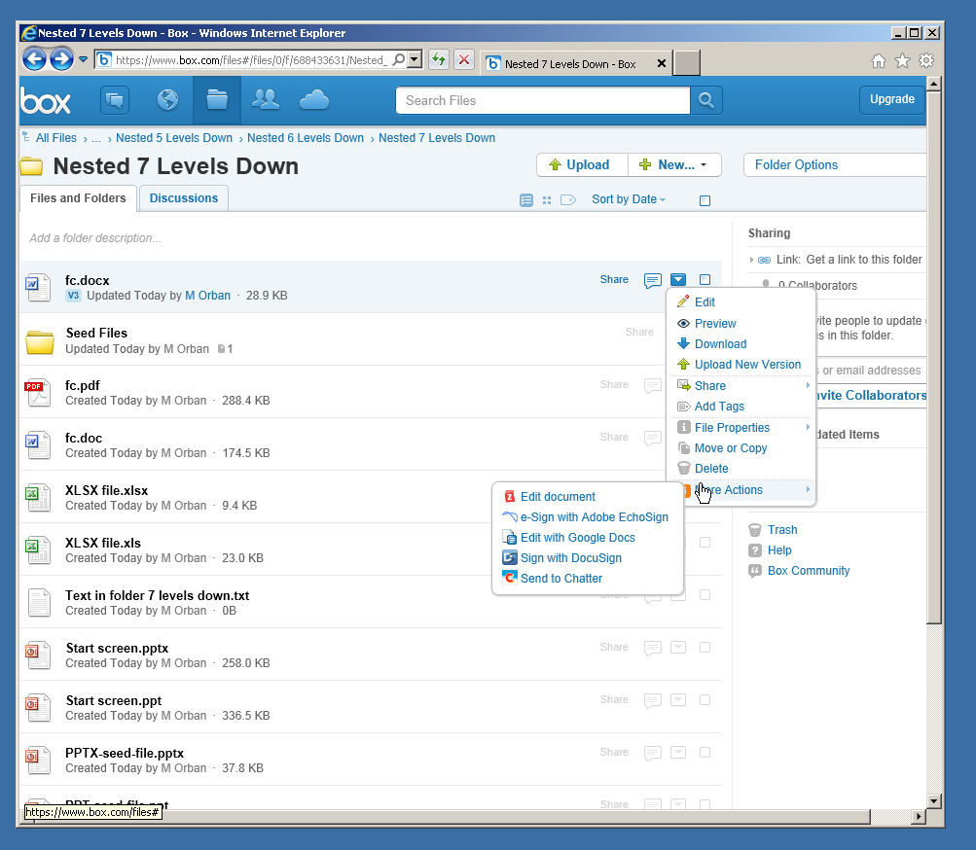

Slide 77
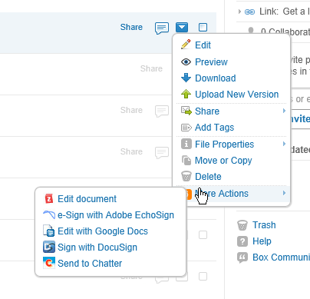

Slide 78
One option in the second pop-up context menu is you can send the file over to your "Google Docs" account for editing. "Google Docs" works as a "Software As A Service" Web-based application that is "integrated" with the "Box" cloud storage service.

Slide 79
The "Box Drive" app creates a special local folder called "Box" in in "File Explorer" in a Windows.. computer or in "Finder" in a MacOS computer. This folder displays ALL of shortcuts that point to the files and folders that are currently stored up at the Box cloud storage service.

Slide 80
By default, the file and folder icons that you see inside the local "Box" folder are shortcuts that point to the files or folders that are stored up at the "Box" server farm instead of being the actual files and folders.
From inside the local "Box" folder in "File Explorer" in your computer, you can right click on any folder and make it "..available offline" but you cannot do so for individual files.

Slide 81
Do not confuse the various apps that Box offers: "Box Sync" app is used for uploading files and folders and synchronizing files between a local "Box Sync" folder in "Windows or a MacOS computer AND the "Box" server farm. The "Box Sync" app can be downloaded and installed from https://community.box.com/t5/Using-Box-Sync/Installing-Box-Sync/ta-p/85

Slide 82
Both the "Box Sync" app and the "Box Drive" app cannot both be installed into an specific Windows.. or MacOS computer:
For any specific Windows.. or MacOS computer, you can either install "Box Sync" or "Box Drive".

Slide 83
Both the "Box Sync" app and the "Box Drive" app cannot both be installed into an specific Windows.. or MacOS computer:
For any specific Windows.. or MacOS computer, you can either install "Box Sync" or "Box Drive".

Slide 84
"Box Edit" app is used for downloading files from the "Box" server farm and then automatically opening them in the default editing program that is already installed on your local "Windows.." PC or Mac running "OS X". See https://app.box.com/services/browse/official/box_edit

Slide 85
All Box "apps" occassionally update themselves:

Slide 86
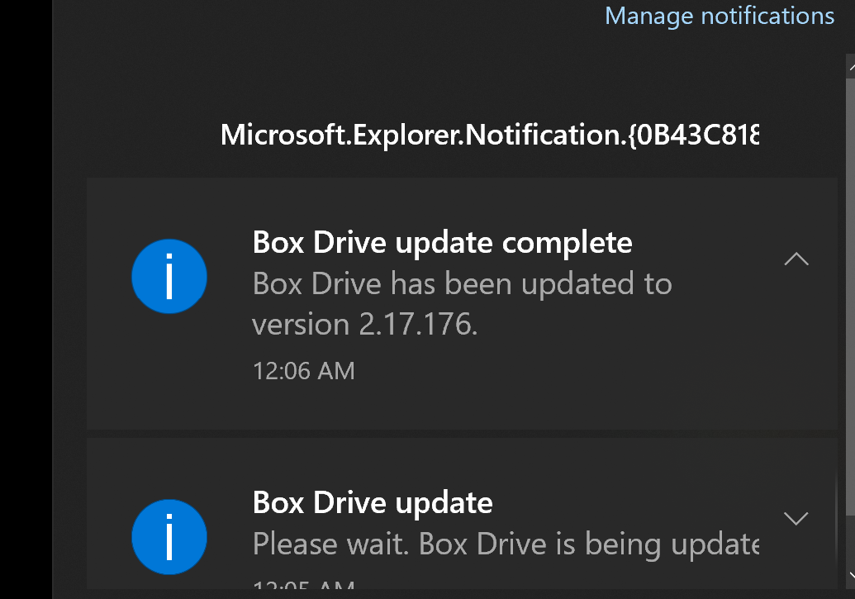

Slide 87
Report Card for "Box" (continued)
If you drag a file or folder into the local "Box Sync" folder, a copy of the file will be uploaded to the top level "root" directory of your account at the "Box" server farm. However, if you delete the file or folder in the local "Box Sync" folder it will also be removed from the top level "root" directory of your account at the "Box" server farm.

Slide 88
After uploading a local file up to the "Default Sync Folder" at the "Box" server farm, you should immediately move the new file to A "subfolder" location at the "Box" server farm, to prevent your actions in the local "Box Sync" folder in "Windows.." from inadvertently deleting the file.

