Slide 1



000-DRIVE CONFIGURATIONS
IN PERSONAL COMPUTERS
1

Slide 2
Web location for this presentation:
http://aztcs.apcug.org
Click on "Meeting Notes"
or contact fchao2@yahoo.com
2

Slide 3
SUMMARY
Your desktop or laptop computer has internal hard drives and internal solid state drives. Most computer users also purchase and attach external USB hard drives, USB external solid state drives, USB drive enclosures, and USB flash drives to use with their computers.
3

Slide 4
TOPICS
Drives Inside Most Computers: M.2 Solid State Drives 3 1/2-in. SATA hard drives 2 1/2-in. SATA drives
External Drives For Computers USB flash drives USB drives USB SATA drives and enclosures USB M.2 drive enclosures
4

Slide 5
DRIVES INSIDE MOST COMPUTERS
Most desktop and laptop computers have two types of drives inside them: SATA drives and M.2 drives
SATA stands for "Serial AT Attachment"
5

Slide 6
DRIVES INSIDE MOST COMPUTERS (continued)
A SATA drives has two connectors: a "SATA data port" and a "SATA power port"
The "SATA data port" connects to a "SATA port" on the motherboard
"SATA power port" connects to a "SATA power port" on the "Power Supply Unit" of the computer
6

Slide 7
DRIVES INSIDE MOST COMPUTERS (continued)
Some older laptops use mSATA drives where the SATA data connector and the SATA power connector are combined into a single connector.
7

Slide 8
SATA BASICS
"SATA" means "Serial AT Attachment" "AT" stands for "Advanced Technology"

Slide 9
SATA BASICS (continued)
Older SATA hard drives conform to standard called "SATA Revision 2" = "SATA II" which runs at 3 Gigabits per second.
Current SATA hard drives and SSDs conform to standard called "SATA Revision 3" = "SATA III" which runs at 6 Gigabits per second.

Slide 10
SATA BASICS (continued)
For the past 5 years, the the bootable C: drives of most Windows.. computers consist of an M.2 Solid State Drive because they are much faster than 2.5-in. SATA SSDs or the even slower 3.5-in spinning hard drives

Slide 11
SATA BASICS (continued)
Maximum cable length of 39.37 inches for SATA data cables (1 meter)

Slide 12
SATA BASICS (continued)
SATA data connections from motherboard to SATA hard drive:

Slide 13
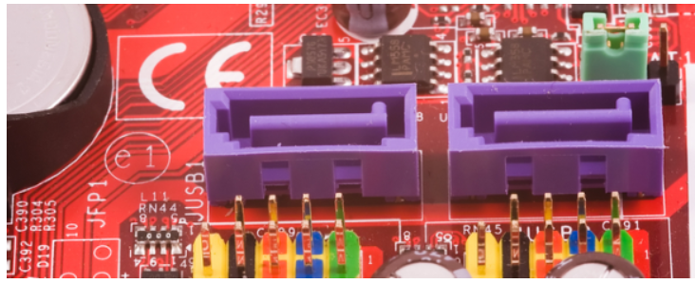

Slide 14
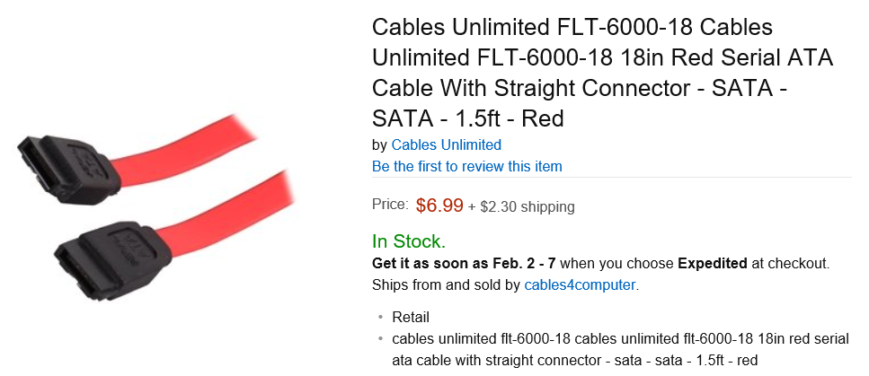

Slide 15
SATA BASICS (continued)
The following images show the bottom side of a typical SATA hard drive:

Slide 16
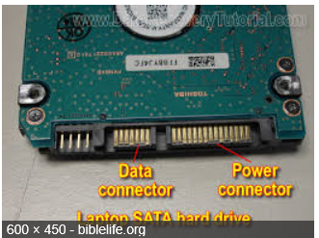

Slide 17
SATA BASICS (continued)
SATA data connection from motherboard to an internal SATA hard drive:

Slide 18
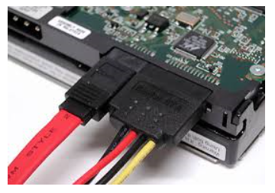

Slide 19
SATA BASICS (continued)
SATA power cable from power supply of a desktop computer to an internal SATA hard drive:

Slide 22
"M.2 NVMe PCIe" SSDs
"M.2" is pronounced "M dot two".
"NVME" stands for "Non-volatile Memory express"
The current up-to-date M.2 NVME SSDs only has an M key:
Requires an M.2 socket that has printed circuit board traces that go back to 4 separate PCIe lanes of the processor chip set

Slide 23
"M.2 NVMe PCIe" SSDs (continued)
From a top view of an M.2 NVME PCIe SSD, the M key looks like this:

Slide 24
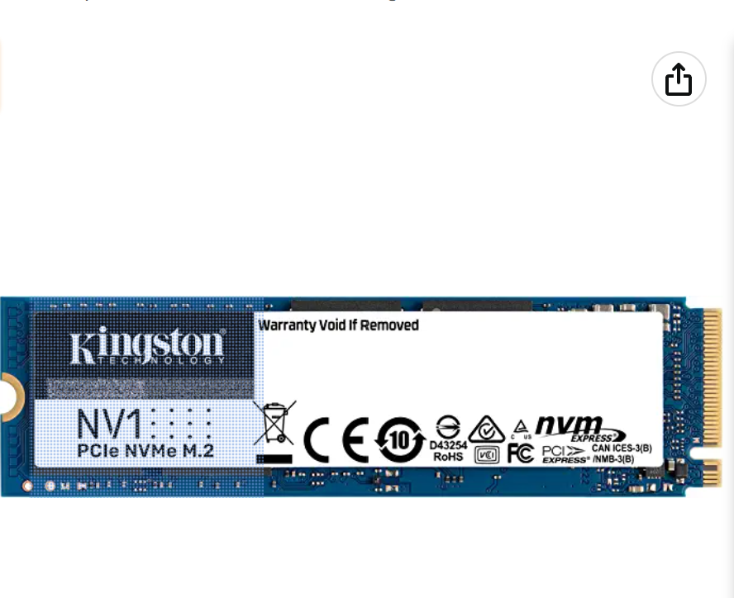

Slide 26
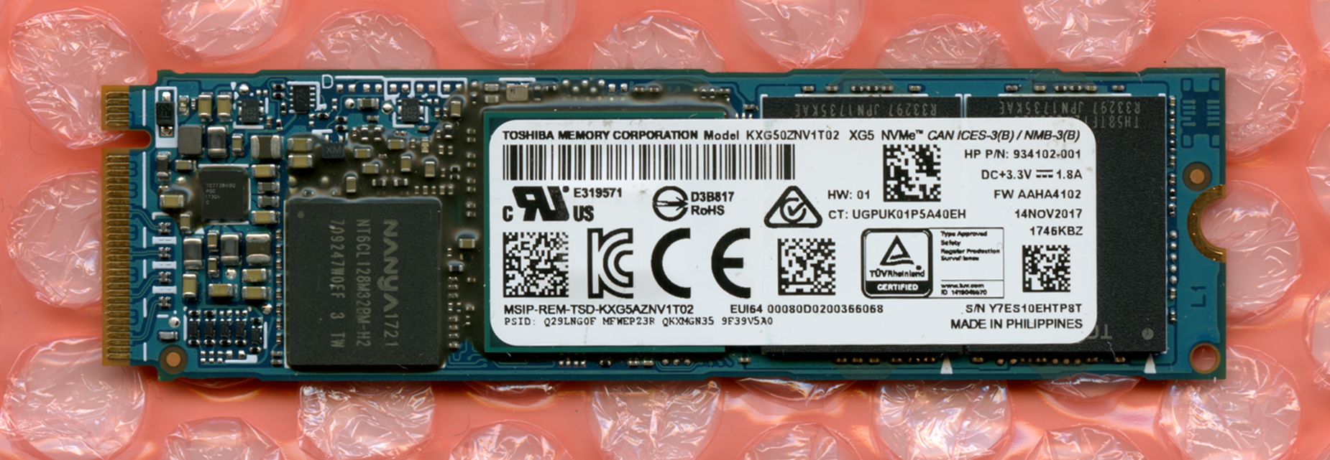

Slide 27
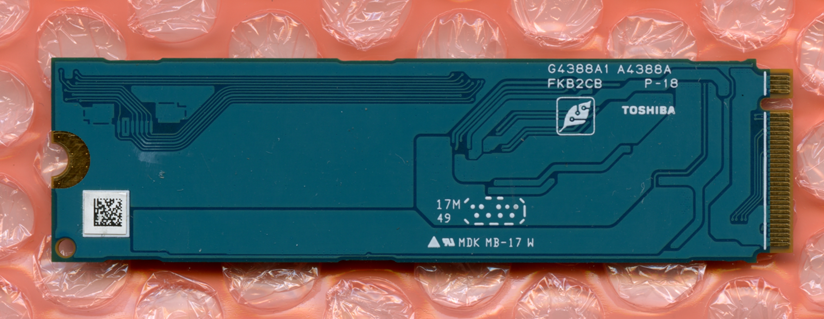

Slide 28
"M.2 NVMe PCIe" SSDs (continued)
Some of cheaper manufacturers put their label on the bottom side of the M.2 SSD: The key to locating the top side of the M.2 SSD is to locate the missing gold trace which is only on the top side of the SSD:
28

Slide 31
"M.2 NVMe PCIe" SSD (continued)
The M.2 form factor SSD is inserted into the M.2 connector with the M.2 form factor board at a 25 degree angle relative to the printed circuit board.

Slide 32
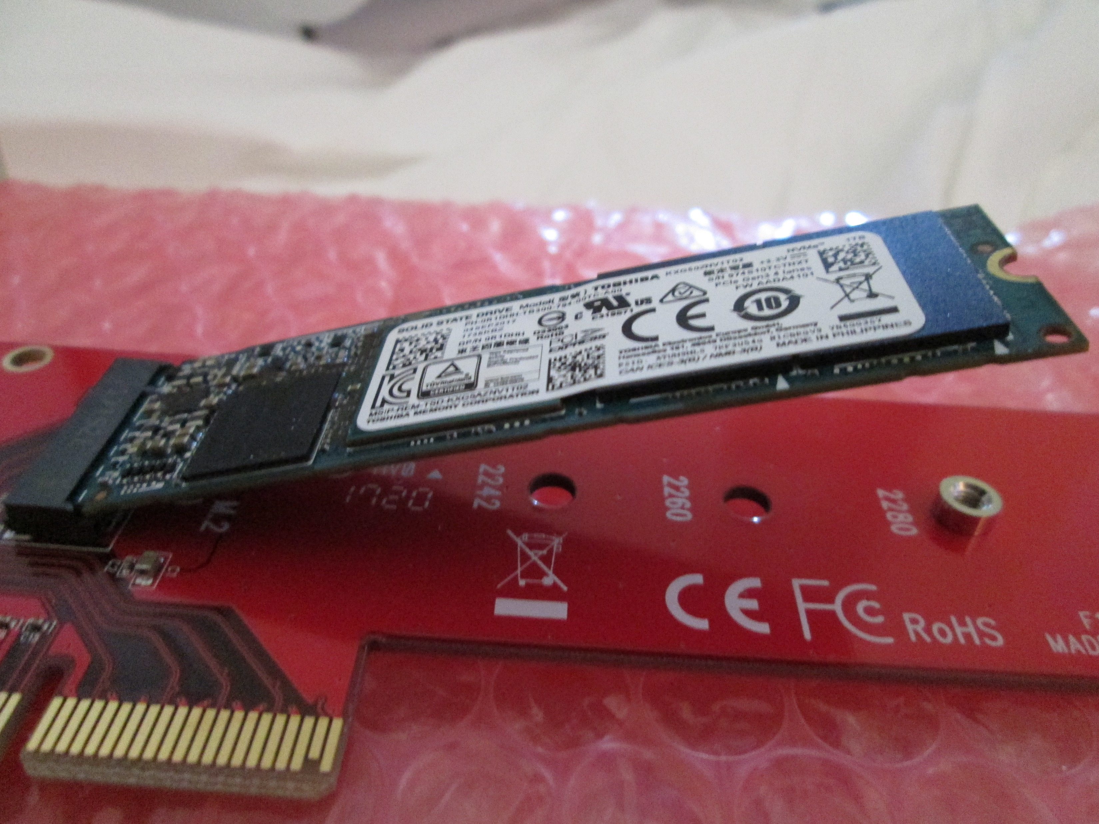

Slide 33
"M.2 NVMe PCIe" SSDs (continued)
Push down so that the drive is parallel to the plane of the motherboard or add-on board

Slide 35
"M.2 NVMe PCIe" SSDs (continued)
Install a Philips hold-down screw that is provided by the motherboard or M.2 enclosure manufacturer:

Slide 37
"M.2 NVMe PCIe" SSDs (continued)
When removing or inserting a M.2 SSD into an M.2 slot that is on the motherboard of computer, you will need two small tools: 1) a "screw-holding jeweler's pick up tool" and 2) a "jeweler's Phillips screwdriver":

Slide 38
"M.2 NVMe PCIe" SSDs (continued)
A set of jeweler's pickup tools is available at https://www.amazon.com/dp/B0BYRMKKPF?psc=1

Slide 39
"M.2 NVMe PCIe" SSDs (continued)
A set of jeweler's screwdrivers is available at https://www.amazon.com/Screwdriver-Different-Screwdrivers-Precision-Jewelers/dp/B0CLV4T6NR/

Slide 40
EXTERNAL DRIVES FOR COMPUTERS
External Drives For Computers USB flash drives USB drives USB SATA drives and enclosures USB M.2 drives and enclosures
40

Slide 41
EXTERNAL DRIVES FOR COMPUTERS
External USB-attached drives and USB-attached drive enclosures cannot be used for the operating system of "Windows 10.." and "Windows 11":
41

Slide 42
EXTERNAL DRIVES FOR COMPUTERS (continued)
In other words, for "Windows 10" or "Windows 11" computers, the C: hard drive has to reside inside the computer as either a SATA drive or a M.2 drive
42

Slide 43
EXTERNAL DRIVES FOR COMPUTERS (continued)
In other words, for a Windows 10 or 11 computer, if you clone the bootable drive that contains the C: drive partition and the target drive is attached to the computer by means of a USB connection, you cannot use this newly-cloned drive to boot up the Windows.. computer
43

Slide 44
EXTERNAL DRIVES FOR COMPUTERS (continued)
(To get around this problem, I use 1-meter long SATA cables and separate SATA power supplies to put bootable Windows.. drives outside of my Windows 11.. computer)
44

Slide 45
EXTERNAL DRIVES FOR COMPUTERS (continued)
External USB-attached drives can be used for the operating system of any distribution of Linux. In other words, for any distribution of Linux, the Linux operating system can reside on either an internal drive or an external USB-attached drive
45

Slide 46
EXTERNAL DRIVES FOR COMPUTERS (continued)
For the past 5 years, almost all Windows.. computer, both desktops and laptops have an internal M.2 solid state drive where the C: drive and other operating system components are located.
46

Slide 47
EXTERNAL DRIVES FOR COMPUTERS (continued)
For gamers and people who transfer large files and folders between their computers and cloud services, the poorly ventilated M.2 drives inside the these computers often result in the overheating and speed throttling of M.2 drives.
47

Slide 48
EXTERNAL DRIVES FOR COMPUTERS (continued)
For me, after overheating and destroying various M.2 solid state drives, I embarked on a technical adventure of installing active M.2 extension cables, and M.2 cooling devices with fans to stop the overheating of M.2 drives, as explained at https://aztcs.apcug.org/meeting_notes/winhardsig/harddrives/SSDs/M.2/1-M.2-enclosures.pdf
48

Slide 49
EXTERNAL DRIVES FOR COMPUTERS (continued)
If you use free Rescuezilla or the free "CLONEZILLA LIVE" to clone or image a drive that is inside your computer, you will usually need to provide a USB drive or a USB drive enclosure for the "target" of the cloning or imaging process.
49

Slide 50
EXTERNAL DRIVES FOR COMPUTERS (continued)
If you use free Rescuezilla or the free "CLONEZILLA LIVE" to clone a bootable Windows.. drive that is inside your computer, you will have to move the target external USB drive to the existing location of the internal C: drive if and when it fails, before the target drive can be used to boot up the computer.
50

Slide 51
EXTERNAL DRIVES FOR COMPUTERS (continued)
This is because the Windows 10 and Windows 11 operating system will not boot from an external USB-attached drive or drive enclosure. Only Windows 10 and Windows 11 have this problem: Linux and macOS can both boot from external USB-attached bootable drives.
51

Slide 52
EXTERNAL DRIVES FOR COMPUTERS (continued)
If you use free Rescuezilla or the free "CLONEZILLA LIVE" to clone a bootable Linux drive that is inside your computer, you can use the the target drive and attach the target drive via a USB enclosure or adapter to the computer and use it to boot up your computer if and when the internal bootable drive fails.
52

Slide 53
53

