Slide 1




00-"RESCUEZILLA" VERSUS "CLONEZILLA LIVE"
1

Slide 2
Web location for this presentation:
http://aztcs.apcug.org
Click on "Meeting Notes"
or contact fchao2@yahoo.com
2

Slide 3
SUMMARY
"Rescuezilla" and "Clonezilla" are compatible with each other. An "image" that you make with one can be used to "restore" with the other.
3

Slide 4
TOPICS
Clonezilla Live's User Interface
Rescuezilla's User Interface
Clonezilla Live's Web site
Rescuezilla's Web site
Difference in System Requirements
4

Slide 5
"RESCUEZILLA" & "CLONZILLA"
"Clonezilla Live" and "Rescuezilla" are two "Free and Open Source" distributions of "..Linux.." that you can use to create clones and backup images of the hard drives and SSDs in your existing "Windows 10", "Windows 11", and "macOS" computers.
5

Slide 6
"RESCUEZILLA" & "CLONZILLA" (continued)
To use "Clonezilla Live" or "Rescuezilla", you have to place them on a bootable DVD or bootable USB thumb drive and then boot up your "Windows.." computer or "..Linux.." computer:
6

Slide 7
CLONZILLA LIVE'S USER INTERFACE
"Clonezilla Live" has a traditional text-based user interface:
7

Slide 8
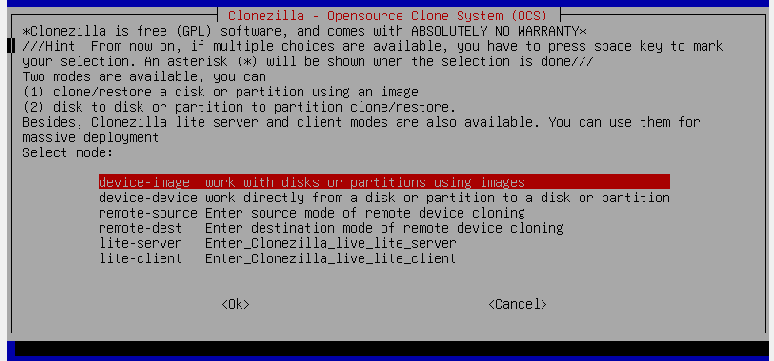
8

Slide 9
9

Slide 10
RESCUEZILLA'S USER INTERFACE
"Rescuezilla" has a graphical user interface:
10

Slide 11
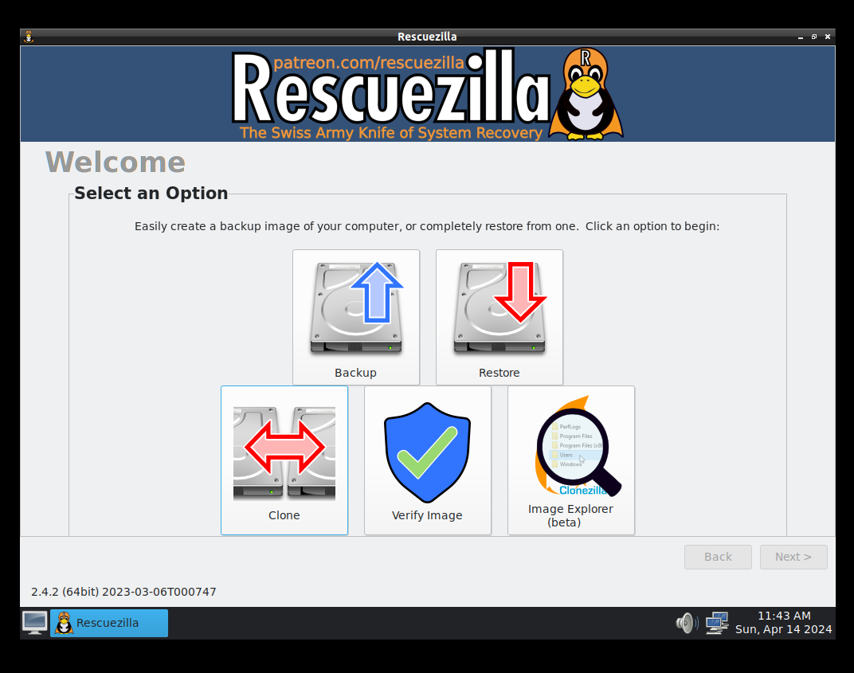
11

Slide 12
12

Slide 13
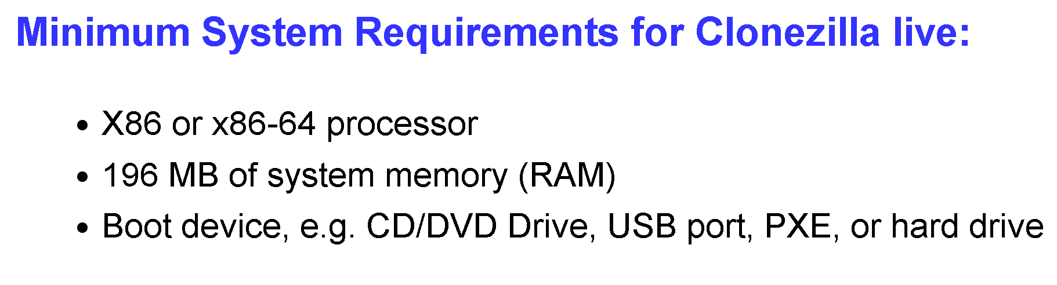
"CLONZILLA LIVE"
Based on "Debian" Linux
Web site is located at https://clonezilla.org
13

Slide 14
"RESCUEZILLA"
Based on "Debian" Linux and "Ubuntu LTS" Linux
Web site is located at https://rescuezilla.com
14

Slide 15
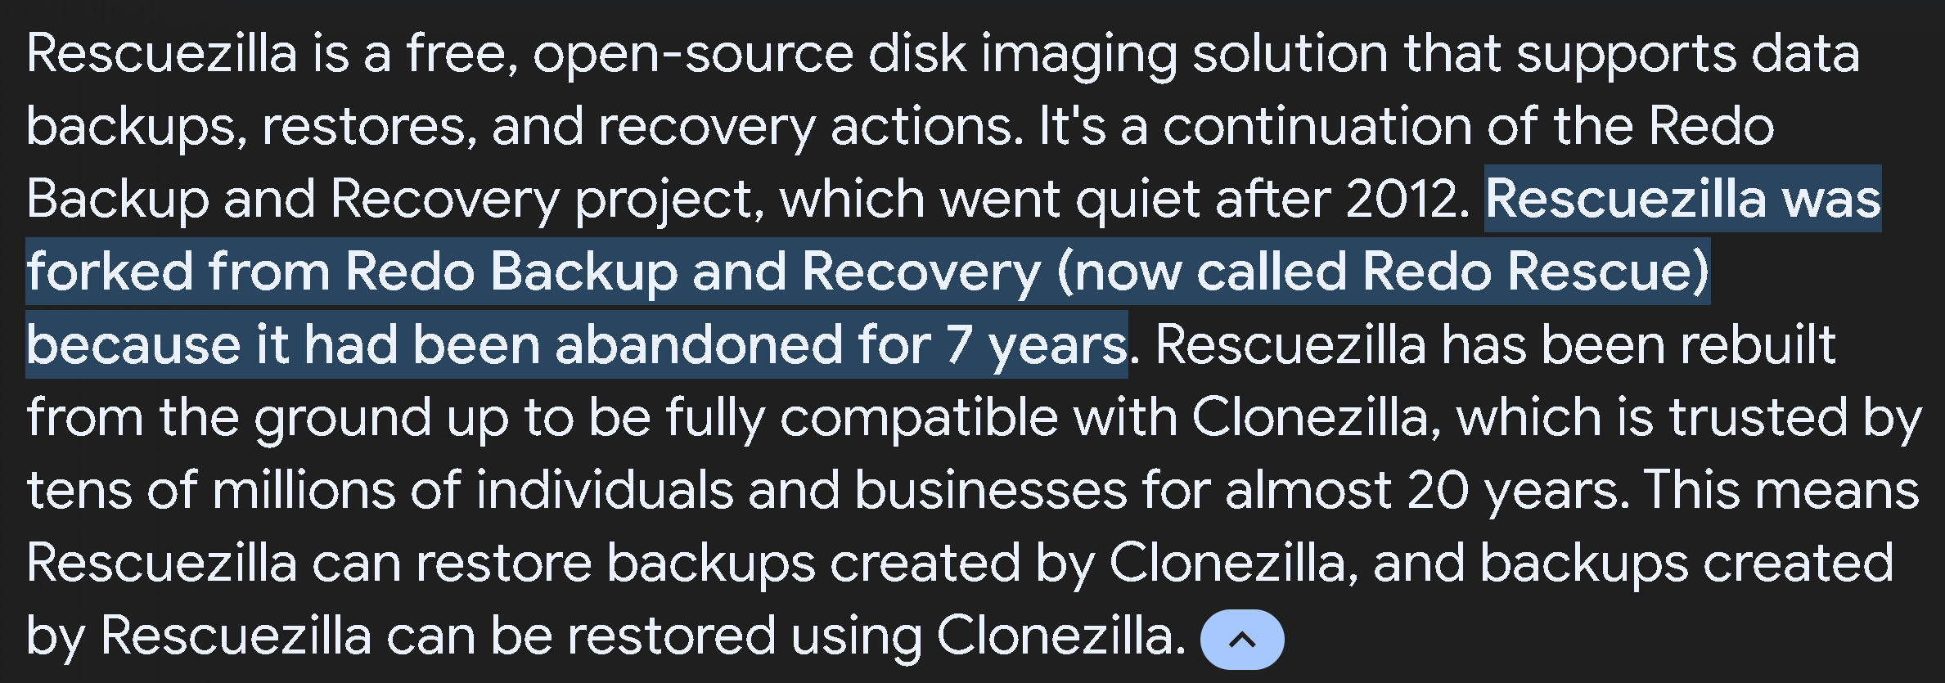
15

Slide 16
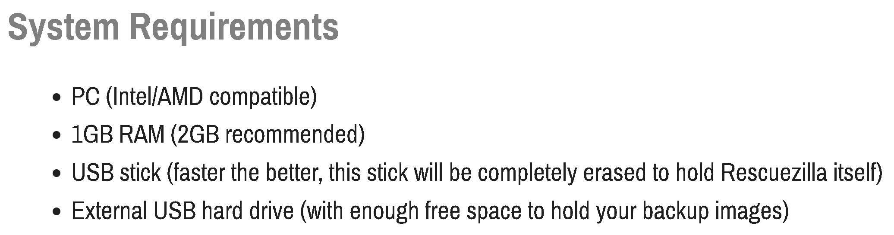
"RESCUEZILLA" (continued)
per https://rescuezilla.com/download
16

Slide 17
SOME ADDITIONAL COMMENTS
Some really old computers will only work with "CLONEZILLA LIVE" instead of "Rescuezilla"
"Rescuezilla" is easier to use
The developers for "CLONEZILLA LIVE" and "Rescuezilla" are separate groups of people that share their source code with each other.
17

Slide 18
SOME ADDITIONAL COMMENTS (continued)
Rescuezilla's developer is located in San Francisco, California: https://github.com/shasheene and https://www.linkedin.com/in/shasheen-ediriweera-22b560276
18

Slide 19
SOME ADDITIONAL COMMENTS (continued)
"CLONEZILLA LIVE" 's developer is located in Taiwan: See https://en.wikipedia.org/wiki/Clonezilla and https://stevenshiau.org/
19

Slide 20
20

