Slide 1



0-CLONING VERSUS IMAGING
1

Slide 2
Web location for this presentation:
http://aztcs.apcug.org
Click on "Meeting Notes"
or contact fchao2@yahoo.com
2

Slide 3
SUMMARY
Cloning and backup are the two ways for you to create a backup of your data files and digital photos.
3

Slide 4
TOPICS
Cloning Versus Imaging
An Example of Cloning
An Example of Imaging
4

Slide 5
CLONING VERSUS IMAGING
Cloning means to make an exact copy of a hard drive, a Solid State Drive (SSD), a CD, a DVD, or a thumb drive onto a similar device that is the same size or larger size than the source media device
5

Slide 6
CLONING VERSUS IMAGING (continued)
Imaging means to make a copy of a the digital files and digital folders on a , a Solid State Drive (SSD), a CD, a DVD, or a thumb drive onto into another storage device as one or more files and folders that are in a proprietary format. The target files and folders are usually compressed smaller than the original source files and folders.
6

Slide 7
CLONING VERSUS IMAGING (continued)
In "Rescuezilla", imaging is done when you click on the "Backup" button
7

Slide 8
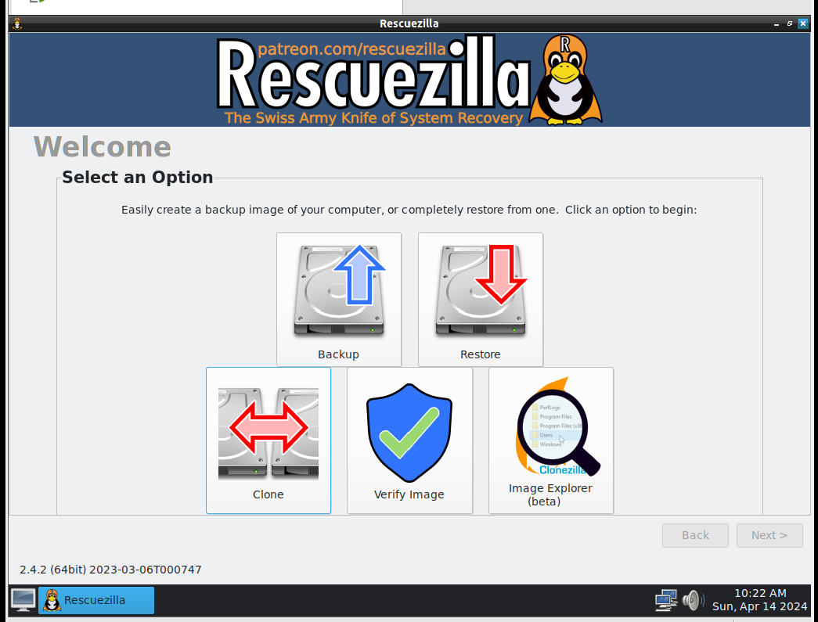
8

Slide 9
CLONING VERSUS IMAGING (continued)
In "Rescuezilla", cloning is done when you click on the "Clone" button
9

Slide 10
10

Slide 11
11

Slide 12
CLONING VERSUS IMAGING (continued)
A "clone" has to reside on a single, unique storage device (i.e. a single hard drive, a single Solid State Drive, a single USB flash drive, a single CD, a single DVD, etc.)
"Images" are proprietary files and folders, more than one "image" can reside on a single storage device
12

Slide 13
EXAMPLES OF A CLONED DISK
The cloned disk can be used as a drop-in replacement for the original source disk if the original source disk fails or if the original source disk is infected by malware. A cloned disk can be used by any computer operating system as a source of data files and digital photos just by attaching it.
13

Slide 14
EXAMPLES OF A CLONED DISK (continued)
A cloned disk can be used by any other computer operating system as a source of data files and digital photos just by attaching it, since a cloned disk has all files and partitions in their native format.
14

Slide 15
EXAMPLES OF A CLONED DISK (continued)
For example, if you attach a cloned hard drive or solid state drive from a Windows.. computer to a Linux computer, your Linux computer can probably access the digital files and photos on the cloned solid state drive. Ditto for a macOS computer.
15

Slide 16
EXAMPLES OF A CLONED DISK (continued)
If you are running a distribution of Linux, your original source disk will look like a mirror image of the cloned disk. In this example, the original source disk is shown on top and the clone disk is shown below it:
16

Slide 17
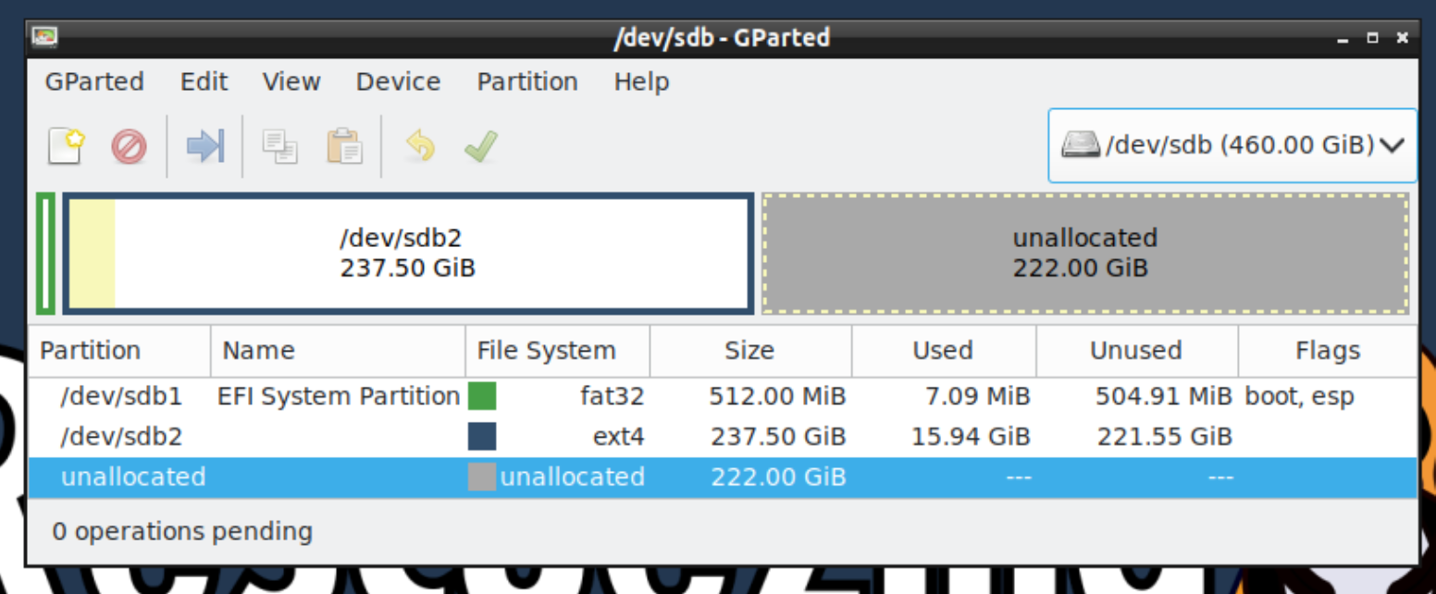
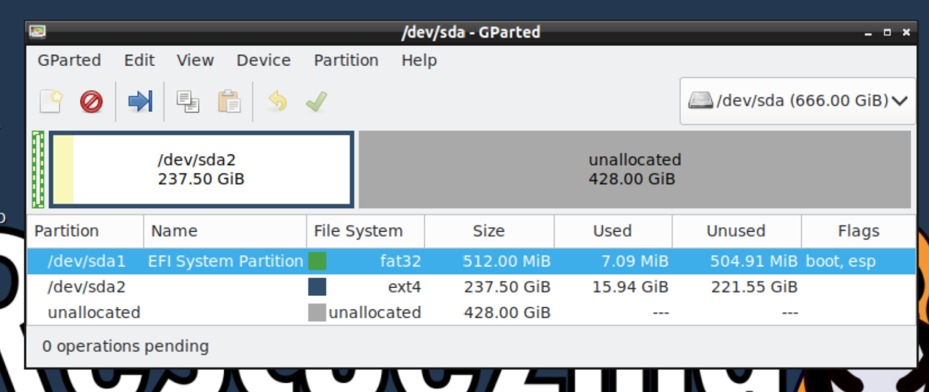
17

Slide 18
EXAMPLES OF A CLONED DISK (continued)
If you are running a distribution of Windows, your original source disk will also look like a mirror image of the cloned disk. In this example, the original source disk is shown on top and the clone disk is shown below it:
18

Slide 19
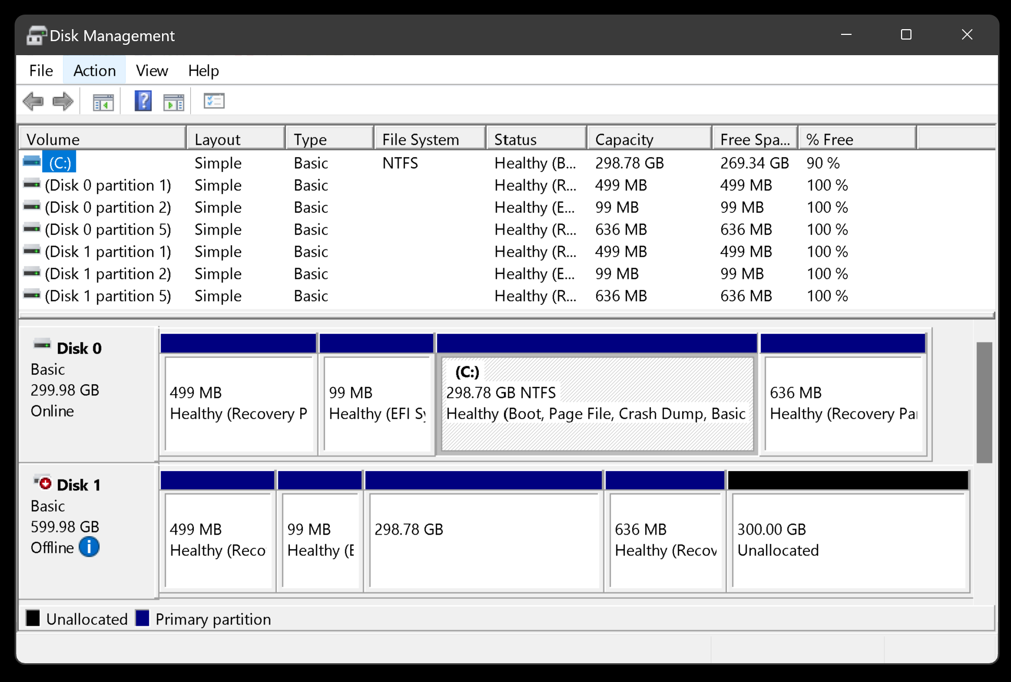
19

Slide 20
EXAMPLES OF A CLONED DISK (continued)
If you click on the white "i" in the blue circle:
20

Slide 21
21

Slide 22
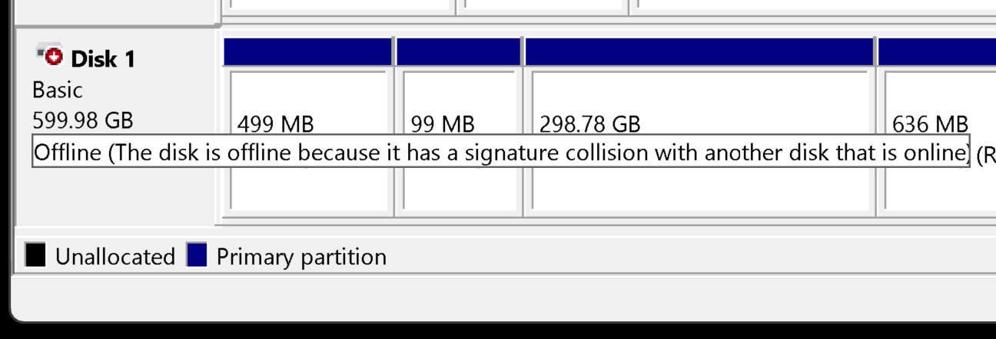
22

Slide 23
EXAMPLES OF AN IMAGED DISK
If you are running a distribution of Windows.., your original source disk will be stored as a proprietary image on the image folder. In this example, the original source disk is shown on top and the clone disk is shown below it:
23

Slide 24
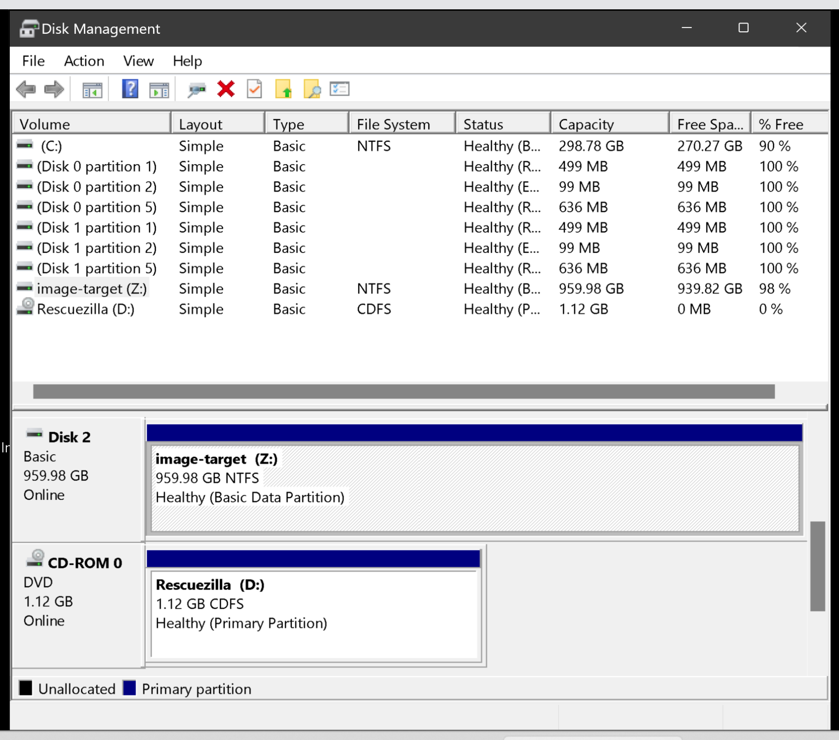
24

Slide 25
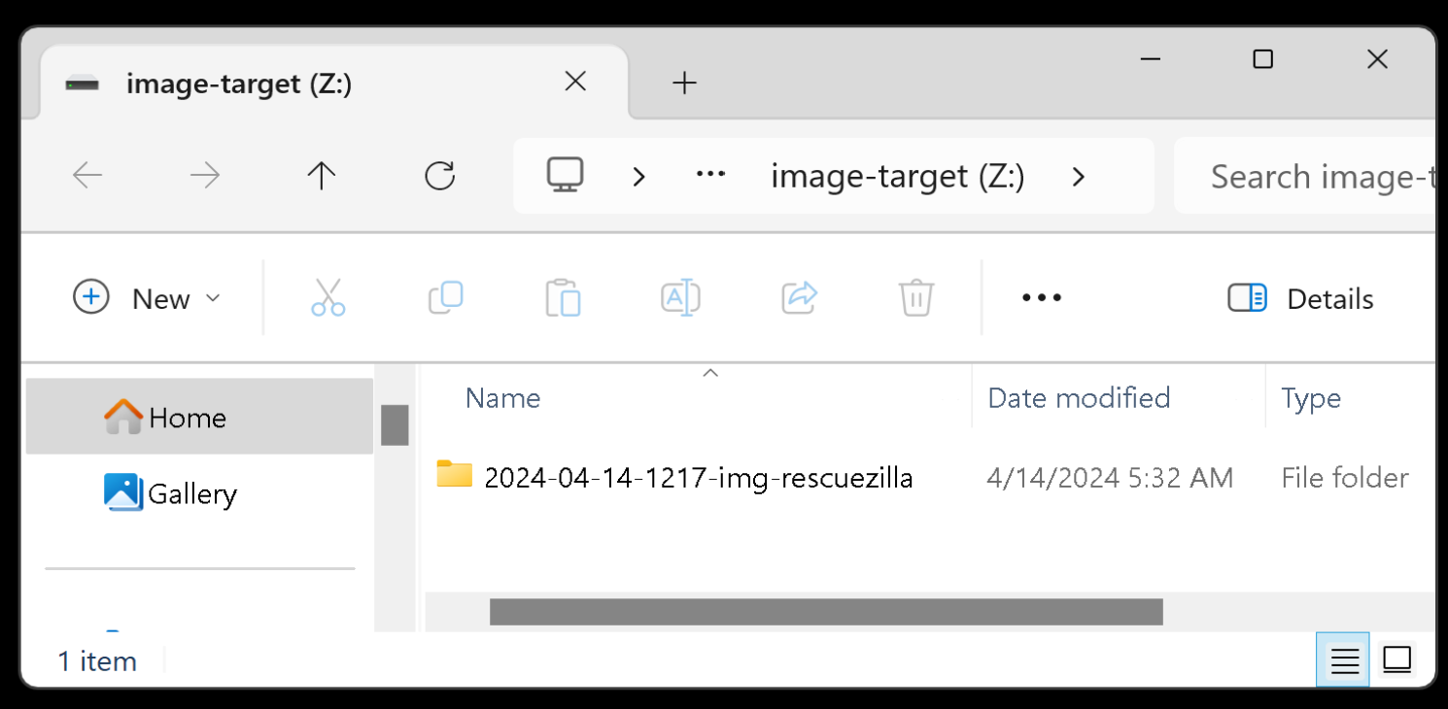
25

Slide 26
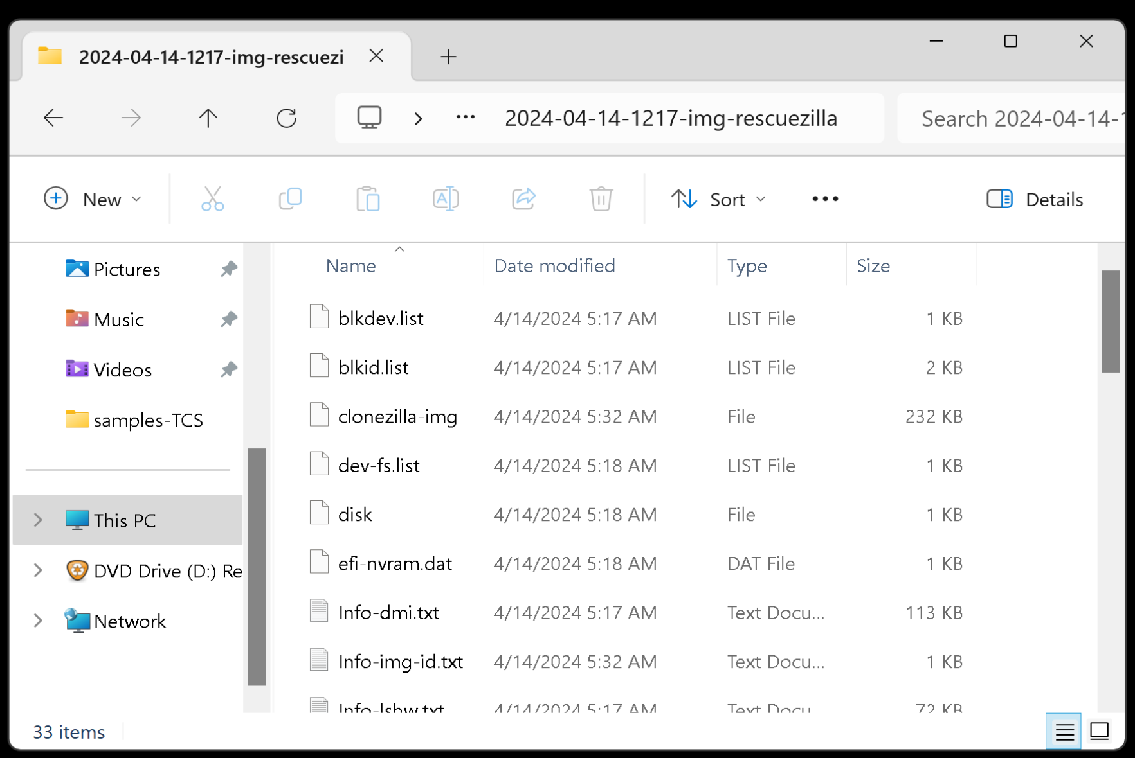
26

Slide 27
EXAMPLES OF AN IMAGED DISK (continued)
To use an previously-created "image" of a disk in Rescuezilla or Clonezilla, you have to use the "Recover" option to "restore" the "image" to a blank hard drive, SSD, or flash drive.
27

Slide 28
28

Slide 29
EXAMPLES OF AN IMAGED DISK (continued)
If you are running a distribution of Linux, the "image files" inside the "image target" hard drive or Solid State Drive will be located at the target drive at a folder such as "2024-04-07-2232-img-rescuezilla"
29

Slide 30
EXAMPLES OF AN IMAGED DISK (continued)
If you are running Linux Mint, the image target hard drive will be "mounted" at the "media" folder since Linux distributions show additional hard drives or Solid State Drives as "mounted" to the "media" folder:
30

Slide 31
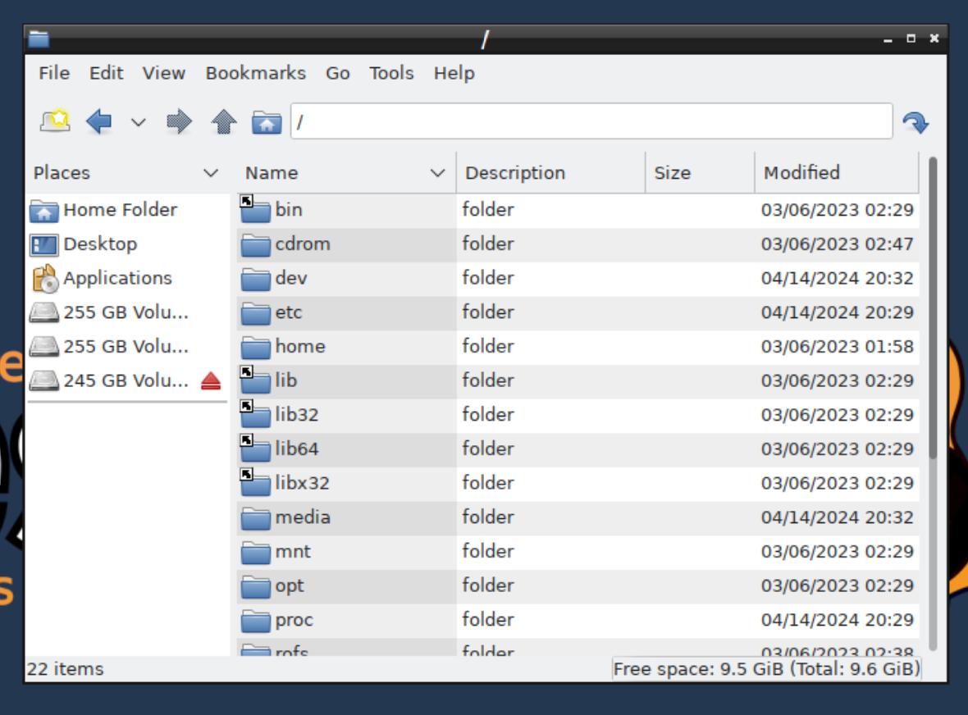
31

Slide 32
32

Slide 33
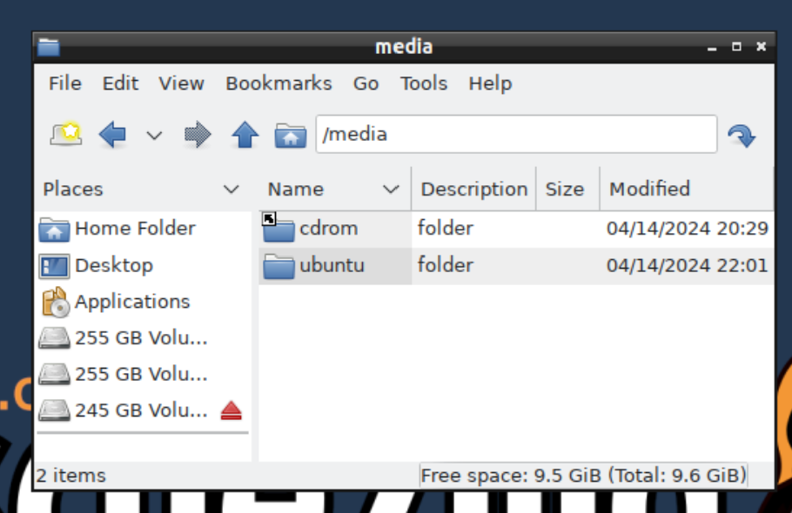
33

Slide 34
34

Slide 35
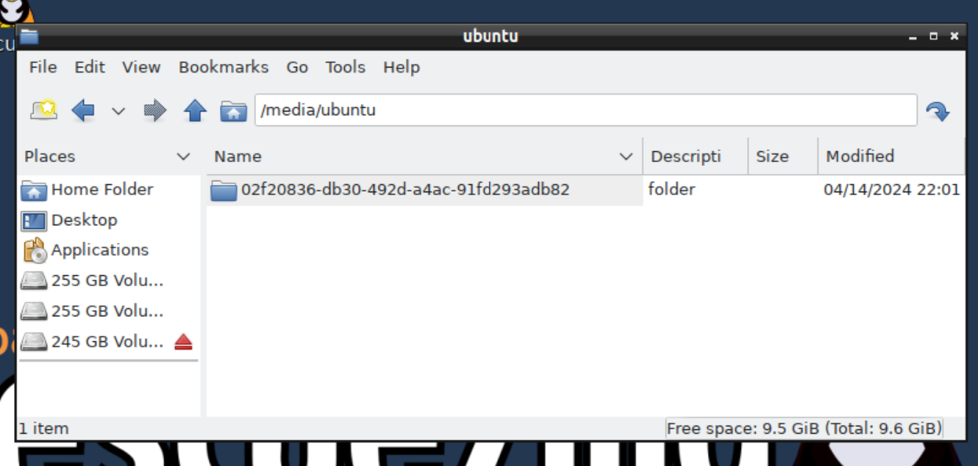
35

Slide 36
36

Slide 37
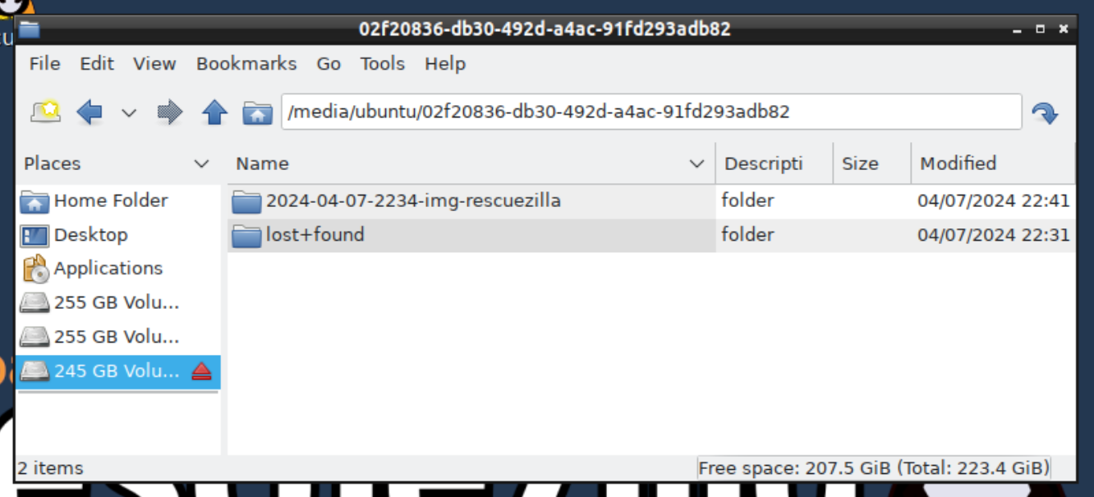
37

Slide 38
38

Slide 39
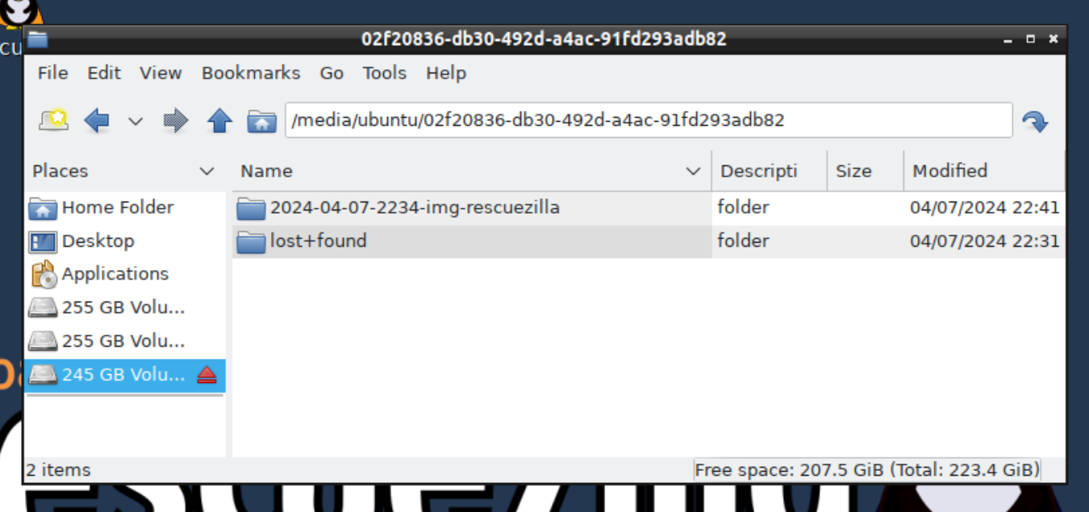
39

Slide 40
40

Slide 41
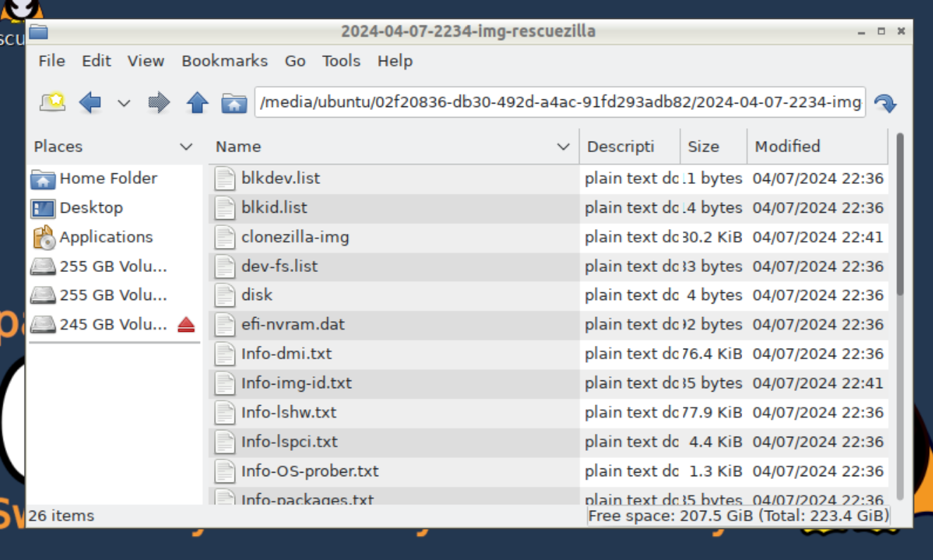
41

Slide 42
EXAMPLES OF AN IMAGED DISK (continued)
You can sometimes extract/recover digital files and/or photo files from the image using the "Image Explorer (beta)" of "Rescuezilla". However it is very beta at the present time and usually fails:
42

Slide 43
43

Slide 44
44

Slide 45
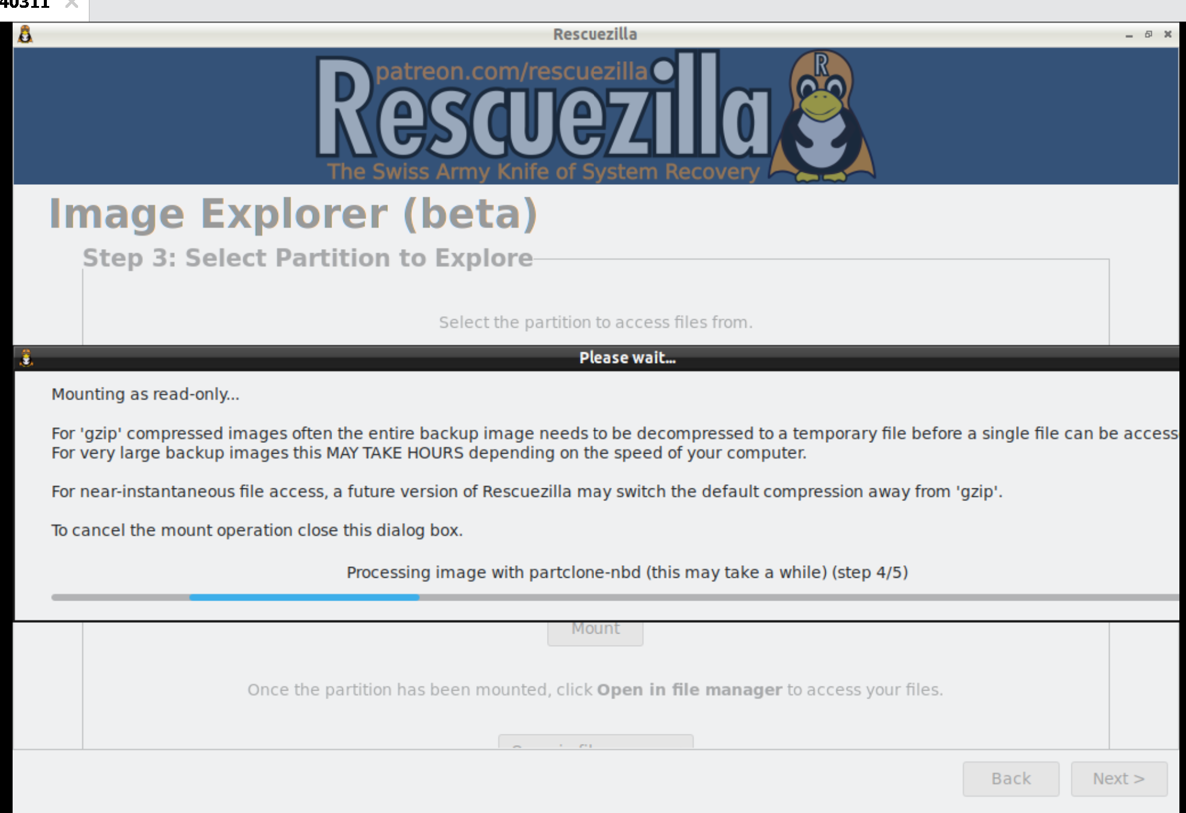
45

Slide 46
EXAMPLES OF AN IMAGED DISK (continued)
You can "restore" the image to another blank hard drive or blank SSD in order to get an exact copy of the original source hard drive or source SSD. The "restore" process has to be done with either "Rescuezilla" or "CLONEZILLA LIVE".
46

Slide 47
47

Slide 48
48

Slide 49
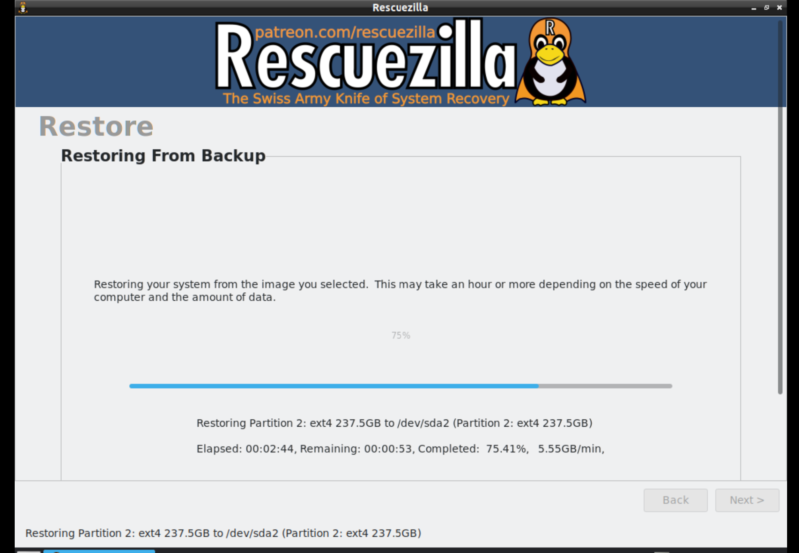
49

Slide 50
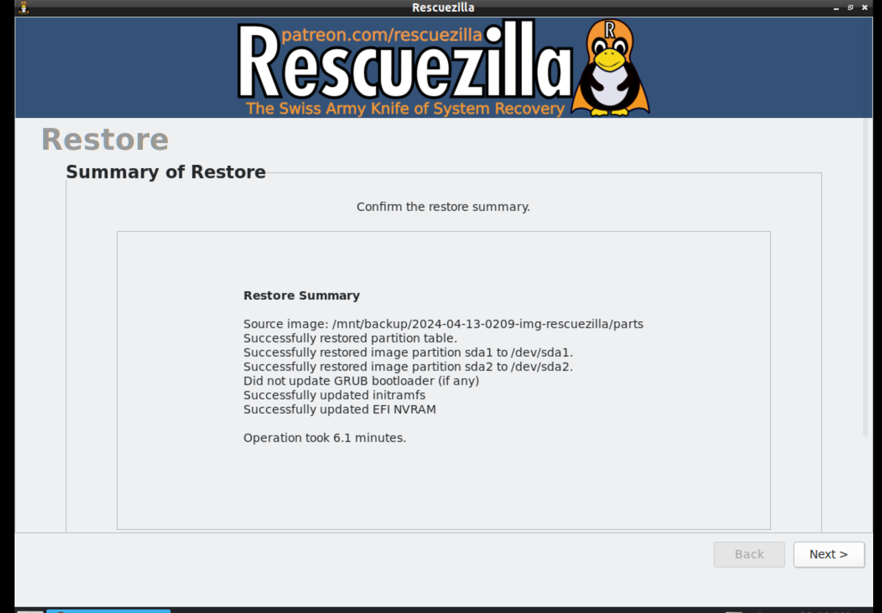
50

Slide 51
EXAMPLES OF AN IMAGED DISK (continued)
The restored target will be an exact copy of the original source hard drive that was used to make the image:
51

Slide 52
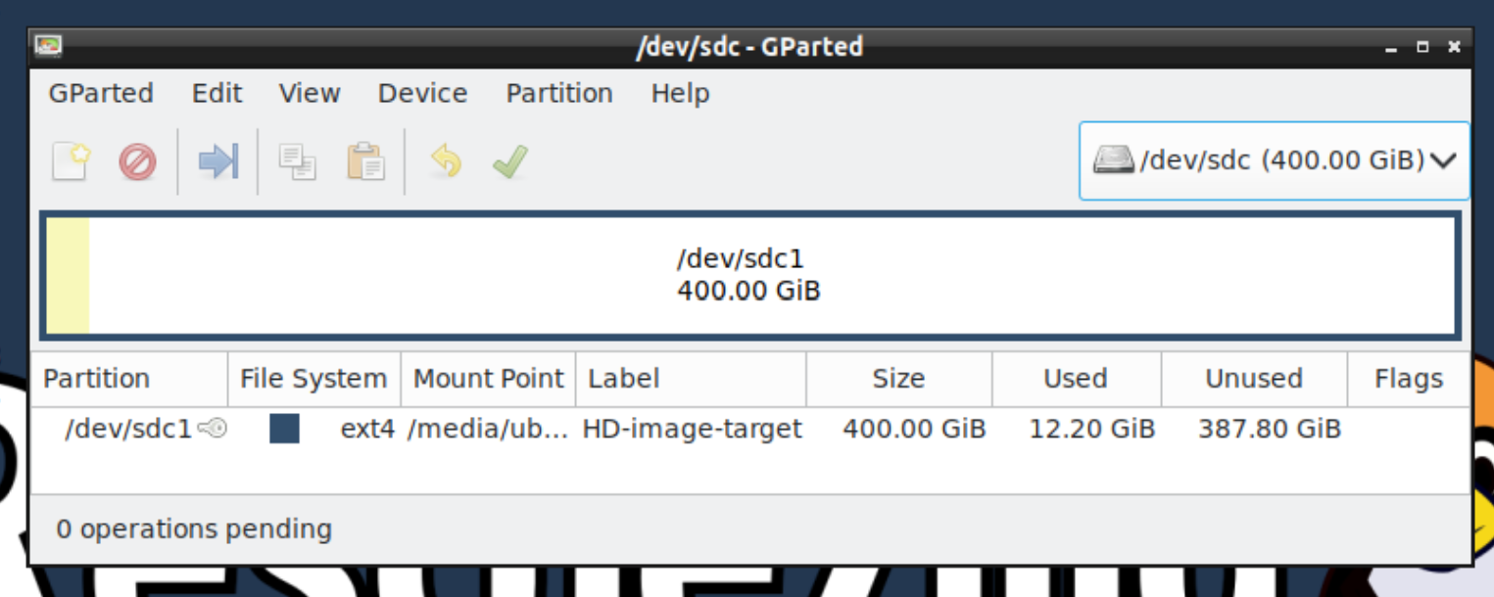
52

Slide 53
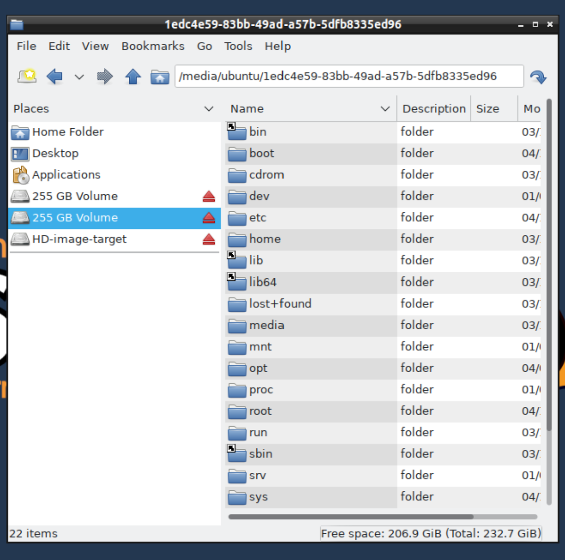
53

Slide 54
54

Slide 55
55

